Slide 1
Youth Conference
25 Márta 2017
Deirbhile Nic Craith
Director of Education and Research

Slide 2
Education
School Governance
Curriculum & Assessment
Social Inclusion
Early Childhood Education
Special Education / Inclusion
School Induction
Teacher Education

Slide 3
Teachers should be at the heart of policy debate.
(Policy Research in Educational Settings: contested Terrain, Jenny Ozga, 2000)

Slide 4
Vision for Education in INTO
To be the leading voice in education policy development
To anticipate and be prepared for emerging trends in education
To determine and lead major movements / trends in education
To be to the fore in progressing education issues
To respond to both national and international research
To be aware of broader developments in Education

Slide 5
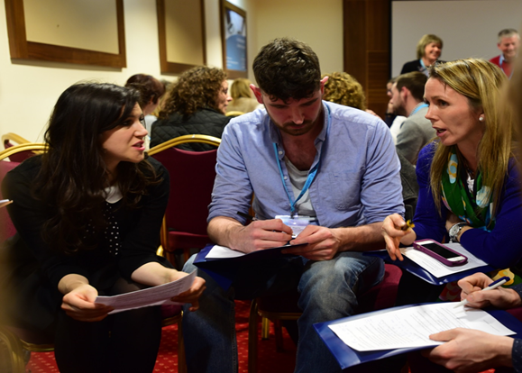
How do we do this?
Representation
Consultations
Conferences
Publications
Research

Slide 6
Representation
National Council for Curriculum and Assessment (NCCA)
Teaching Council
An Chomhairle um Oideachas Gaeltachta & Gaelscolaíochta (COGG)
National Consultative Forum on Special Education

Slide 7
Consultations
Recent Topics
Primary Language Curriculum
Literacy and Numeracy Strategy
New Allocation Model for Special Education
Current Consultation
Structure of Primary Curriculum and Time Allocation across the Curriculum
Process
Questionnaires
Consultation Discussions within Districts
Email

Slide 8
Consultation Meetings

Slide 9
Conferences
Annual Consultative Conference on Education
Biennial consultative Conference on Special Education
Biennial Consultative Conference for Principals and Deputies
Triennial Consultative Conference on Equality
National Youth Conference
Occasional Conferences / Seminars
DEIS
School Placement

Slide 10
Research
Background papers for conferences
Collaborative projects
Teachers’ Experience of Standardised Testing in Primary Schools – INTO and CARPE (Centre for Assessment Research Policy and Practice in Education)
INTO Bursary for Educational Research
The voice of Teachers
Questionnaires / Surveys
Focus Groups

Slide 11
Publications
Intouch
Irish Teachers’ Journal
Proceedings of Conferences
Submissions

Slide 12
Professional Development
Summer Programme
Online Courses
Facilitation Skills Seminar to support consultations

Slide 13
Members (40,423)
Education Committee
Branches(180)
Equality Committee
Districts (16)
Principals’ and Deputy Principals’ Committee
Central Executive Committee (22)
16 elected representatives, President, Vice-President, Ex-President, General Secretary, General Treasurer and Northern Secretary
Northern Committee
Congress
Accounts Committee, Standing Orders, Benefit Funds Committee

Slide 14
Education Committee
Sixteen elected members
Three-year term
Supported by Officials
Deirbhile Nic Craith and Nuala O’Donnell
Current Issues in Education
Consultative Conference on Education
Consultations with members
Research – questionnaires and focus groups

Slide 15
Current Issues in Education
Curriculum and Assessment
Revision of Primary School Curriculum
Language Curriculum
Mathematics
Literacy & Numeracy Strategy
Early Childhood Education
Teacher Education
ITE, Induction, CPD
School and Teacher Evaluation

Slide 16
Consultative Conference on Education
Teaching in the 21st Century
2009 The Arts in Primary Education
2010 Learning Communities
2011 Literacy
2012 Wellbeing
2013 Numeracy
2014 Quality in Education – Teacher Responsibility and Accountability
2015 The Primary School Curriculum
2016 100 Years of Teaching 1916-2016

Slide 17
Activist professionalism
Activist teacher professionalism is not for the faint-hearted. It requires risk-taking and working collectively and tactically with others … the activist teacher professional creates new spaces for action and debate, and in so doing improves the learning opportunities for all of those who are recipients or providers of education
(Judyth Sachs, 2003, p. 153)

Slide 18
The involvement and commitment of teachers, with a sense of ownership and responsibility for decision-making, is an essential element for innovation (Brown et al, 1995, p.10)
Policy research (especially policy research) is a fundamental right of and responsibility for teachers (p. 36)

Slide 19
Context of
Practice
Context of
Influence
Context of
Text
(Bowe, Ball, with Gold 1992)

