Slide 1
Conditions of Employment
Deirdre O’Connor
Assistant General Secretary
Conditions of Employment

Slide 2
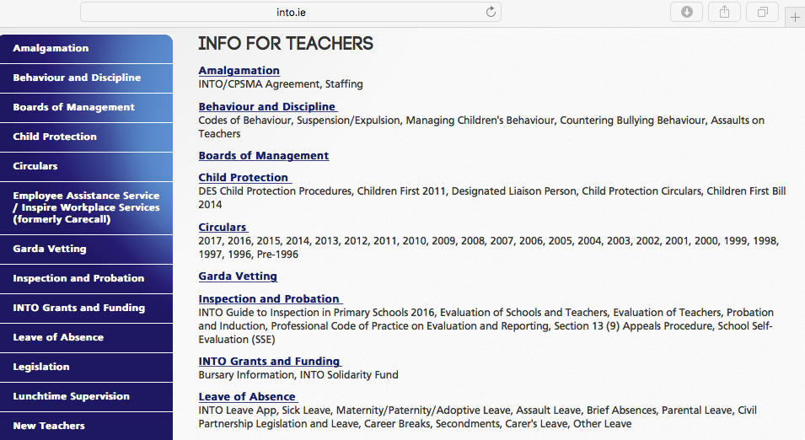
Conditions of Employment (COE)
Sources of Information
Website
Intouch
Leave App
Diary
Social Media
Tuesday e-newsletters
Seminars and meetings
Supplementary Panel meetings
Retirement Planning
Training events/ Conferences

Slide 3
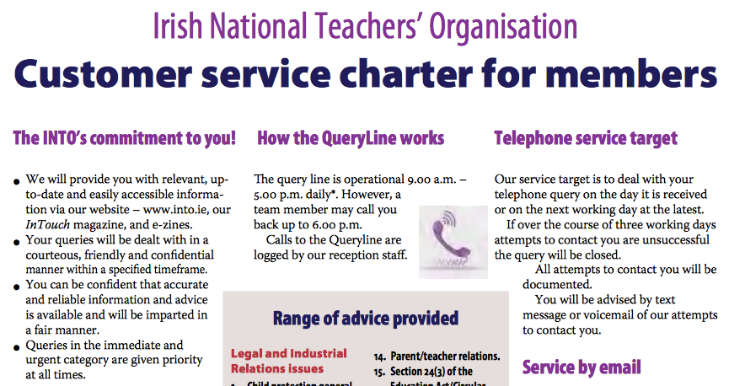
INTO Query Line
01 8047700/ 1850 708708
Monday –Friday 9am-5pm
info@into.ie

Slide 5
COE Queries 2016 by Topic

Slide 6
Security of Employment
Contracts of indefinite duration (CIDs)
513 CIDs granted 2015/2016
489 CIDs granted 2016/2017 (up to November 2016)
Entitlement –
Employment in excess of 2 years continuous teaching service under two or more successive written contracts of employment with the same employer, and
the most recent (ie 3rd year contract) is viable for the school year, and is not covering for an absence (except covering for career break or secondment).
Circular 17/2017 (link)(S.3ii) clarifies that school may use a permanent post arising in the school in the 2017/2018 school year as the viable post to enable appointment to a CID.

Slide 7
Main and Supplementary Panels
Main Panel – for the redeployment of surplus permanent and CID holding teachers
183 - teachers redeployed through the main panel in 2016
Supplementary Panels- priority list for permanent employment
2088 – teachers on the supplementary panel in 2016
811 – teachers placed in permanent jobs from the Supplementary Panel

Slide 8
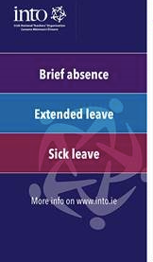
Leave of Absence
Fully paid maternity leave
Sick Leave
1,568 - primary teachers on career break
232 – primary teachers on teacher exchange
1,836– teachers job sharing

