Slide 1


INTO Youth Conference
Saturday March 25th 2017
Cork
Emer Egan – Deputy Chief Inspector

Slide 2
The context for the teacher as professional
Personal motivation to teach
Professional Values
The changing face of society
Evolving understanding of learning

Slide 3







Teaching is a Higher Order Profession
Theory: Skills and Knowledge Base
Implementation in Practice

Slide 4
Supports for Teachers as Professionals
Looking at Our School 2016: A Quality Framework for Schools
SSE / External Evaluation
Teacher Education Providers
Schools / Networks
Teachers / INTO
DES: NIPT, PDST, Ed Centres, Inclusion Service
Teaching Council / Probation – Droichead
We share a common purpose to support world class teaching and learning

Slide 5

Looking at Our School 2016 –
Underpinning a professional approach
Provides unified and coherent sets of standards
Teaching and learning
Leadership and management
Supports meaningful dialogue about quality in schools
Shared professional language
Shared understanding of effective practice
Will help schools
To embed reflective practice
To collaborate and be responsive to learners’ needs
Will inform
Internal school reflection
External evaluation
The work of other agencies

Slide 6
Teaching and Learning
Learner outcomes
Learner experiences
Teachers' collective / collaborative practice
Teachers' individual practice
Notes:
=

Slide 7
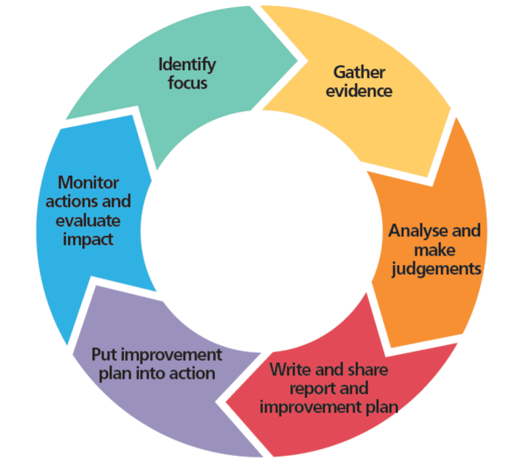
Reflection at School Level…a tool for better learning
How good is my teaching? How good are the pupils’ outcomes?
How can I share my teaching with others?
How can my school become a learning organisaton?
SSE Six Step Process
Notes:
How good are the learning outcomes?

Slide 8
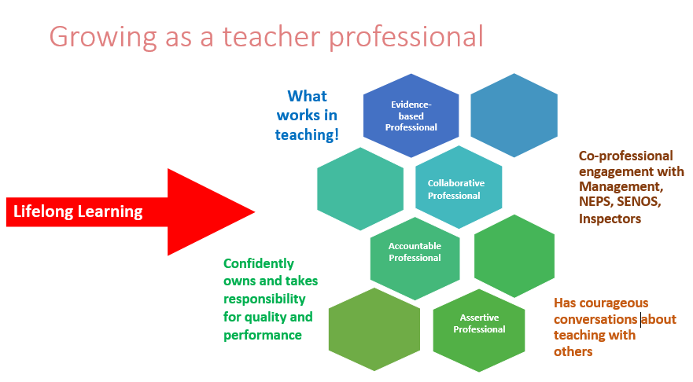

Slide 9
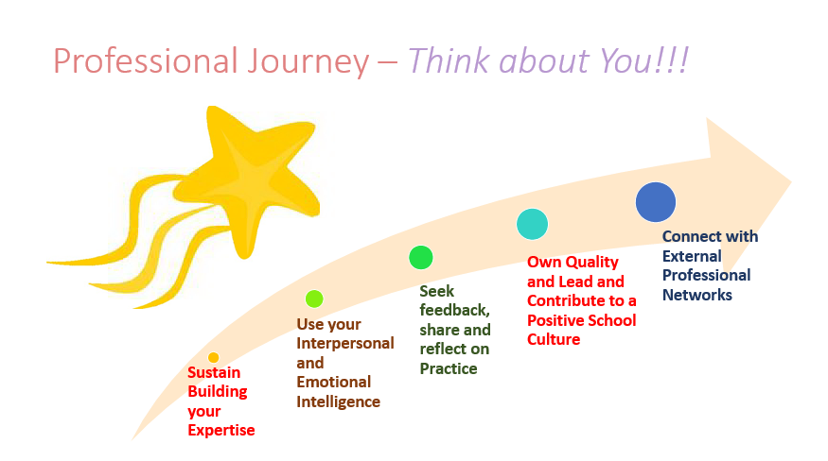

Slide 10

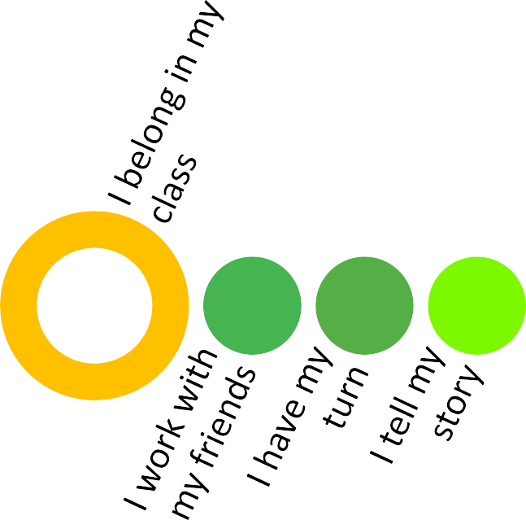
As a professional, you have a profound impact on the life of a child

