Slide 1
Using Coaching Skills to build positive Relationships In our Schools – JENNIFER BARRON

Slide 2
Relationship Skills
Positive Relationships at Work are established by developing three conditions:
Equality
Create wins for everyone
Provide Autonomy
Relationship Skills involve consciously managing and developing interpersonal relationships – not only with peers, staff and students, but also with everyone in our school community. Remember, relationships thrive by taking a collaborative approach where each relationship is treated as a partnership

Slide 3
Relationship Skills
Emotionally intelligent leaders have the knack for establishing and maintaining collaborative and rewarding relationships characterised by positive expectations. They can gain the support and commitment of others and value working with others to achieve their goals.
When low:
• Difficulties engaging well with others
• Seen by others as aloof or impersonal
• Not interested in relationships
When high:
• Enjoys others’ company and making new friends
• Gets on well with colleagues
• Likes helping people achieve what they want

Slide 4
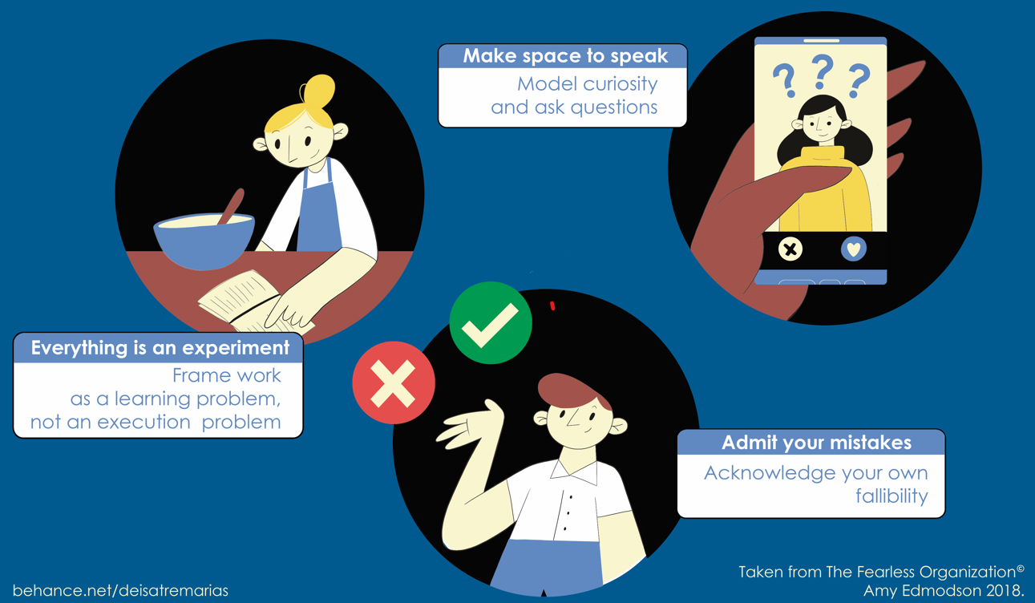
Relationship SKILLs
CHOICE & VOICE
When we are in a trusting, safe environment, we should feel safe to be vulnerable.
Can we ask for help?
Can we admit a mistake?
Can we offer an alternative?

Slide 5
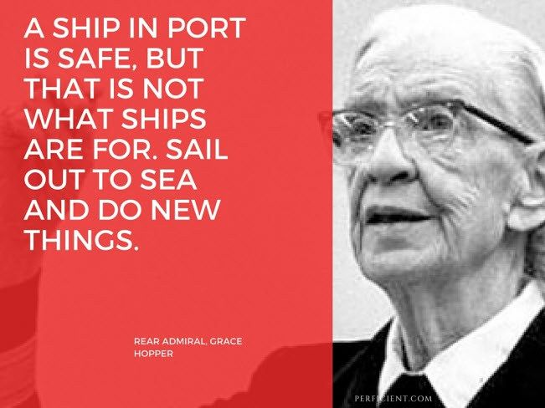
What is your ‘new thing’?

