Slide 1
LESSON 5
Trade Union Movement in Modern Ireland

Slide 2
MOVING ON FROM THE 1913 LOCKOUT
Although Larkin and his colleagues didn’t get what they wanted immediately in 1913, over the following years many improvements came for workers.
Right to be a MEMBER of a trade union
Improved PAY and CONDITIONS
THE LABOUR COURT – helps to find agreement when employers and workers disagree
COLLECTIVE BARGAINING became more common
EQUAL PAY for men and women
Notes:
Although Larkin and his colleagues didn’t achieve their objectives they gave workers hope as a collective group and recognition amongst the wider public in standing up for workers’ rights and supporting fair pay and working conditions for all workers. The Labour Party was also established around this time and they continued to lobby on behalf or workers and seek to represent them at local and national level.
You can find out more about the Labour Court here: www.workplacerelations.ie/en/WR_Bodies/Labour_Court

Slide 3
UNIONS TODAY
Unions in Ireland today have a common set of aims.
Improve pay and working conditions
Improve relationships between workers and employers
Negotiate on behalf of members in wage agreements and collective bargaining
Represent members in disputes
Promote equality for all members and oppose discrimination
Notes:
Trade unions represents their members in disputes e.g. in collective bargaining, in issues around changes of work practice etc.
Promoting equality e.g. ensuring men and women doing the same role get the same pay and challenging employers if this isn’t the case.

Slide 4
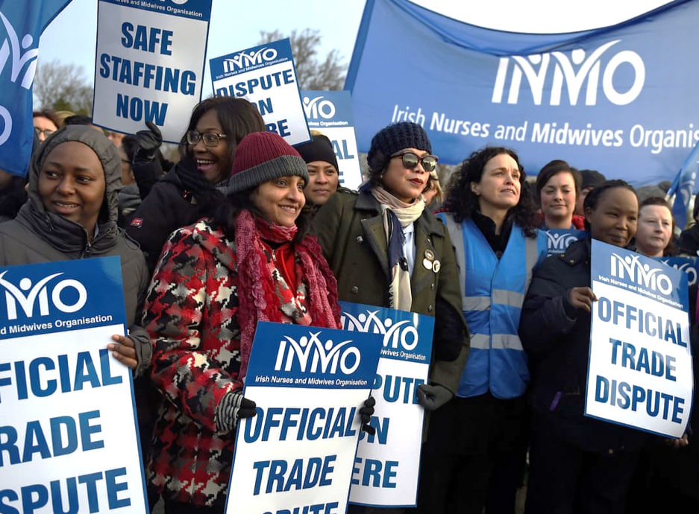
INMO MEMBERS ON STRIKE
Notes:
Irish Nurses and Midwifes Organisation (INMO) is the trade union that represents nurses and midwifes working in the public sector in Ireland.
The INMO is also a member of a bigger group called the Irish Congress of Trade Unions-ICTU who negotiate with the Government on behalf of groups of unions (known as collective bargaining).
As these nurses/midwifes work in public hospitals their employer is the Government of Ireland.
INMO members were unhappy with the Government as they were finding it very hard to recruit (hire) and retain (keep) nurses who were trained in Ireland.
As a result of this the nurses who were working in hospitals were under a lot of pressure and were finding it hard to look after all their patients and hospitals couldn’t recruit/retain enough nurses to have safe staffing levels.
The INMO looked for talks with the Government (their employer) to discuss the problem but the Government said they wouldn’t negotiate with them further as they were already included in a pay agreement called the Public Service Stability Agreement (PSSA).
The nurses argued that there was space within that agreement to discuss their issue but the Government did not agree.
The INMO decided it was necessary to ballot their members for strike action. This means asking their members to vote to withdraw their labour as a form of protest.
The nurses went on strike for three days between January and February 2019. They picketed hospitals and withdrew their labour on these days.
The Government agreed to meet for talks to resolve the issue in the Labour Court and the INMO and ICTU representatives.
The nurses were offered a deal which included more pay and recognition of their qualifications in return for no more industrial action.
To find out if members accept this deal the INMO ballots its members.

Slide 5
GROUP ACTIVITY
Scenario (3 mins) groups of 6:
Paramedics are looking for a pay rise of €5 an hour from next month.
Group members must take on the roles of:
HOSPITAL MANAGERS (3 people)
TRADE UNION NEGOTIATORS (3 people)
Each trio must argue why it is in their best interests to GRANT/DENY THIS REQUEST.
You must give reasons to JUSTIFY YOUR POSITION.
Time for you to try out your NEGOTIATION skills!

Slide 6
OUTCOME OF NEGOTIATIONS
The Management have offered the Paramedics two options:
A rise of €2 an hour in their CURRENT CONTRACTS.
OR
A rise of €3.50 an hour if they agree to sign a NEW CONTRACT that requires them to start a half an hour earlier each day.
Discuss in pairs:
As a trade union representative which option would you RECOMMEND your staff take and WHY?
Notes:
Discuss with the class what do trade union officials do after the discussion e.g. ballot their members, meet as an executive committee and issue a recommendation to members etc.

Slide 7
WHAT HAVE WE LEARNED?

