Slide 1


Presentation to INTO Youth Conference
Máirín Ní Chéileachair
NIPT National Co-Ordinator
Saturday 25th March 2017

Slide 2
National Induction Programme for Teachers
Purpose:
To support the professional growth of teachers during the induction phase
Vision:
Quality induction for every teacher
Motto:
Seeking support is a sign of strength

Slide 3
National Induction Programme for Teachers
Our programme of support
Induction workshops
Cluster meetings
School Support
Phone and email support
CPD for experienced teachers (Professional Support Team Training)
Staff presentations
Information Sessions
Website
Shared Learning Events

Slide 4
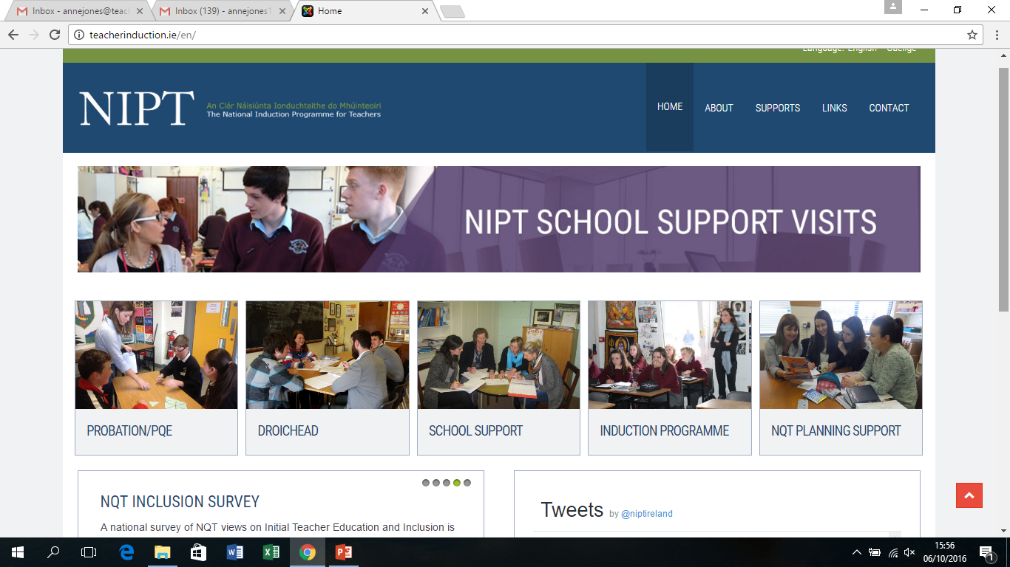
The National Induction Programme for Teachers (NIPT)

Slide 5
The Continuum of Teacher Education
Policy on the Continuum of teacher Education (2011) recognises three distinct phases in a teacher’s career.
In reality it can be much more complex than this.
Initial Teacher Education
Droichead
Cosán

Slide 6
Phases of First Year Teachers’ Attitudes Towards Teaching
(Moir, E. New Teacher Centre Santa Cruz 1999)

Slide 7
Induction, only for NQTs?
Research shows that we all need induction when we enter new roles or new phases of our careers.
Changing role within your school: SEN, Post of Responsibility, Principalship
Job sharing
Returning form Career break
Moving to another school
Moving to another educational role

Slide 8
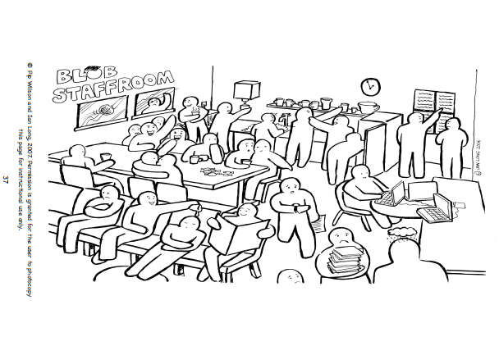
Notes:
Cast their minds back to when they were an NQT: Allow participants some time exploring the blob scene.
Picture the scenario: I am a new blob that arrives into this school. Where do I go? Who could I sit with? Where would I go to find the cups?
Question: What was it like for you when you began teaching? Recall 2 positive experiences and 1 negative experience.
What would have helped you? (perhaps 3 things)
What would it be like to be a new staff member in our school? (If you only have 35 minutes for the presentation you may not have time to do this activity)
Key Message: Induction is a whole school approach. The mentor AND now the PST is the facilitator of the induction process in their school.

Slide 9
Induction, only for NQTs?
What are the principles of good induction?
Progression not Perfection…
Standards
Professional Conversations
Support & Challenge
Reflection and Collaboration

Slide 10

Our careers are a Journey
What does your career journey look like to date?

Slide 11

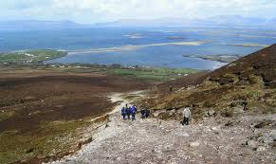
What is yours?
Where am I going and why?

Slide 12
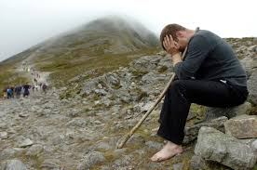
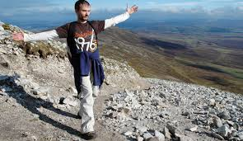
What is yours?
What will it feel like when I get there?
Support and challenge, mentoring and induction will make the difference.

Slide 13
Míle buíochas

