Slide 1
Pride
and the struggle for equal rights

Slide 2
We are Learning To:
Define some key vocabulary related to LGBT+ identities
Identify the origins of the first Pride worldwide
Describe the origins of Pride in Ireland
Explore the ways in which attitudes and beliefs have changed since the 1960s
Discuss the continued significance of Pride as an annual event

Slide 3
Key Vocabulary
Lesbian: A woman who has, or wants to have a loving relationship with another woman.
Gay: An man who has, or wants to have a loving relationship with another man. Some women may also use this term instead of lesbian.
Bisexual: A person who has, or wants to have a loving relationship with another person. The gender of that other person could be male, female or another gender.
Pansexual: Similar to bisexual. A person who has, or wants to have a loving relationship with another person (of any gender identity).
Gender Identity: A person’s strongly held internal sense of their own gender.
Gender Expression: How a person chooses to express their gender identity externally e.g. clothes, haircut, general appearance etc.

Slide 4
Key Vocabulary
Transgender: A person whose gender identity does not match the one that was assigned to then when they were born
Cisgender: A person whose gender identity matches the one that one assigned to them when they were born.
Non-binary: A spectrum of gender identities that are not exclusively male or female. People who identify along this spectrum sometimes use the pronouns ‘they/them’ to refer to themselves.

Slide 5
Key Vocabulary
Pronouns: A word that replaces a noun (usually a person’s name) in a sentence e.g. he, she, they. People will sometimes use their pronouns as part of introducing themselves to make sure that transgender and non-binary people feel included e.g. ‘My name is Ciara, I use she/her pronouns’.
LGBT: An acronym that stands for lesbian, gay, bisexual and transgender identities
LGBT+: An acronym that recognises and includes other minority identities outside of solely lesbian, gay, bisexual and transgender. Other alternatives are also used e.g. LGBTQ, LGBTI, LGBTQIAP etc. People and organisations use the acronym that they feel best matches their members, philosophies and goals.

Slide 6
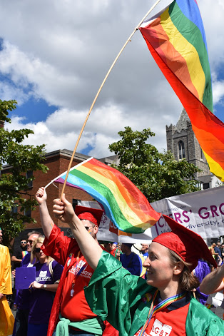
What is Pride?
Pride is an annual celebration of diversity and all members of the LGBT+ community.
It is celebrated in countries all around the world.
A key part of Pride is a parade or march.
Pride is often described as a mixture of celebration and protest.

Slide 7
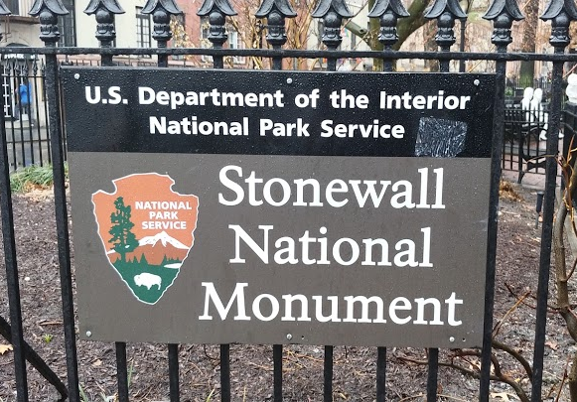
Where did it come from?
The first Pride marches happened in the United States of America in June 1970.
It was in response to the anniversary of the Stonewall riots in New York, which had occurred a year earlier on 28th June 1969.

Slide 8
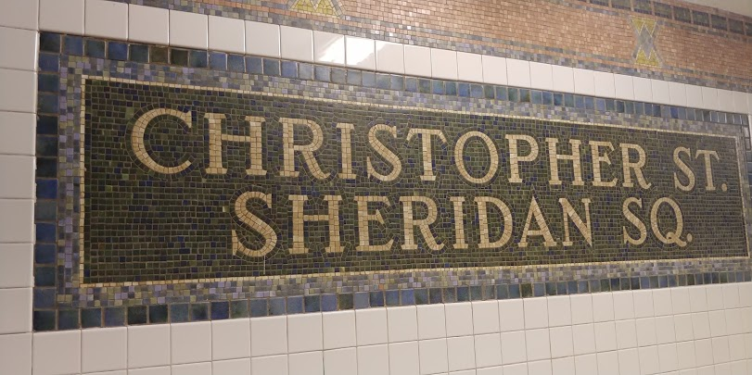
Where did it come from?
The march in New York was called the Christopher Street Liberation Day (after Christopher Street - the street upon which the Stonewall Inn is located).
The pride festivals in some German cities are still called Christopher Street Days.

Slide 9
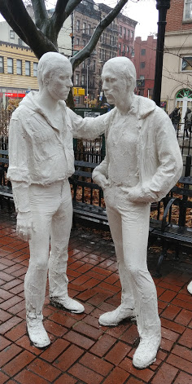
What happened at Stonewall?
LGBT+ citizens of the United States had endured centuries of discrimination and harassment.
In the 1950s and 1960s in the United States, LGBT+ Americans faced an anti-gay legal system.
People could be arrested for just being gay.

Slide 10
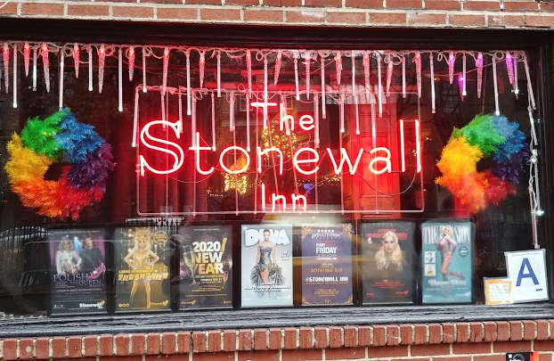
What happened at Stonewall?
New York was seen as ‘being lenient’ because it had reduced homosexuality to a misdemeanour but people could still face 6 months in prison.
Police would sometimes raid LGBT+ establishments or businesses where LGBT+ people were known to visit.
One of these places was The Stonewall Inn.

Slide 11
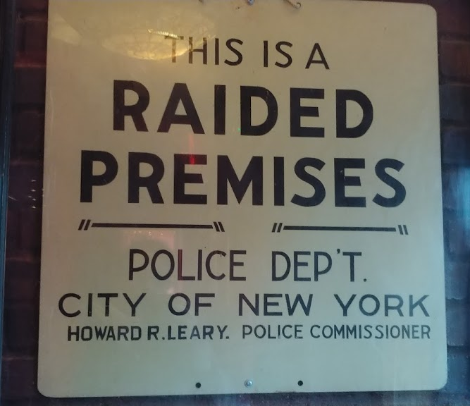
What happened at Stonewall?
At 1.20am on Saturday, June 28th 1969, there was a raid on The Stonewall Inn.
There had been many raids in the time leading up to this and people were tired of the harassment.
Usually, as part of a raid, the people in the inn would have to line up showing their IDs.

Slide 12
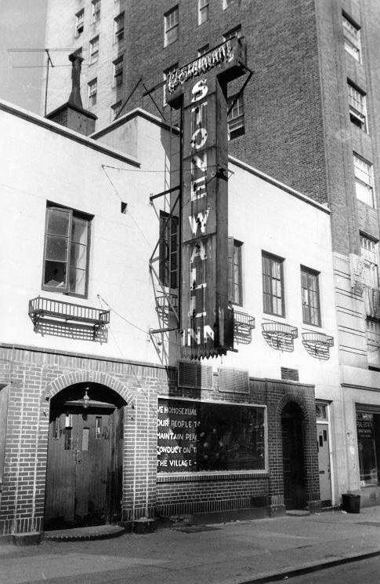
What happened at Stonewall?
The law said that people were required to be wearing at least three pieces of ‘gender appropriate’ clothing.
If they were not, they were often arrested.
However on the 28th June 1969, people did not cooperate with the raid.

Slide 13
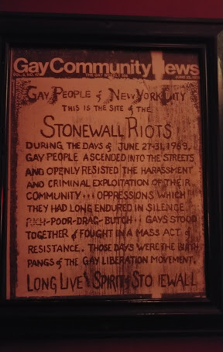
What happened at Stonewall?
Men in line refused to produce their identification.
The police then decided to bring everyone to the police station but they did not have the wagons ready.
A crowd began to gather outside the inn.
As one woman was being moved, she was hit on the head with a baton.

Slide 14
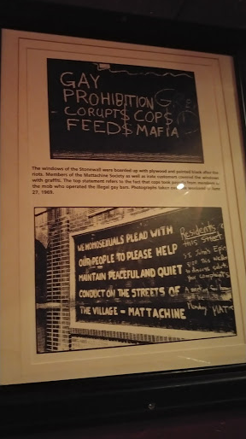
What happened at Stonewall?
She called to the crowd to do something and as she was thrown into the wagon, violence broke out.
In the end, 13 people were arrested but it was the last straw for the LGBT+ community.
Lesbian, gay, bisexual and transgender people were fighting back.

Slide 15
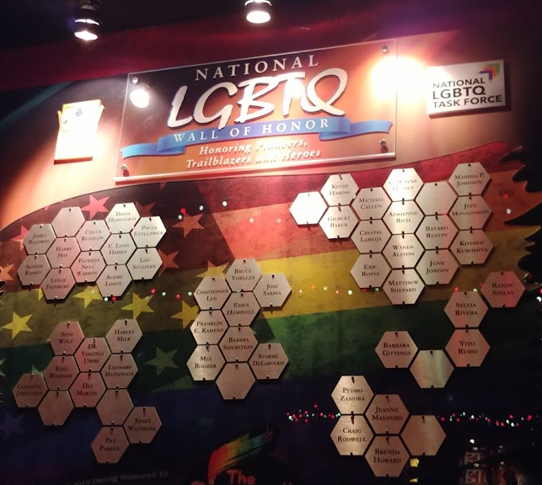
Then What?
On November 2 1960, Craig Rodwell, his partner Fred Sargent, Ellen Broidy and Linda Rhodes proposed a march in NYC for the following summer as an annual reminder of the demonstrations.
A bisexual activist called Brenda Howard was one of those credited with naming the event ‘Pride’.

Slide 16
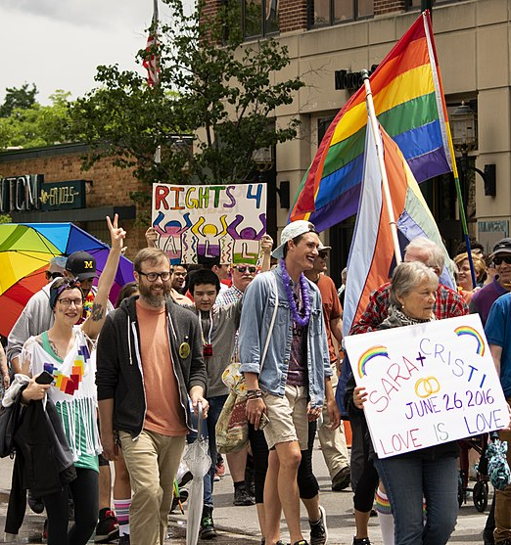
Then What?
This led to her becoming known as ‘The Mother of Pride’.
The march took place on 28th June 1970.
It was a great success and Pride marches began to spread around the United States and then around the world.

Slide 17
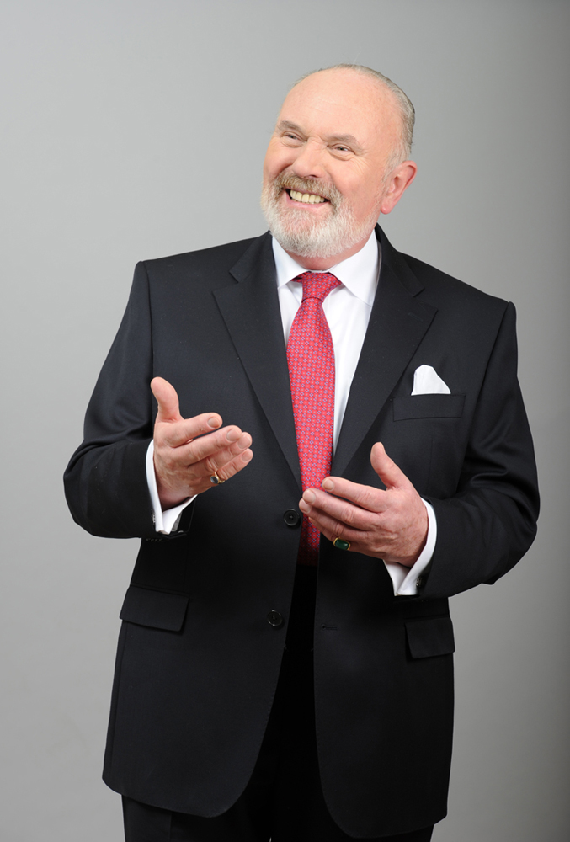
What about Ireland?
This first official LGBT+ demonstration took place in Dublin on 27th June 1974.
10 people (including now Senator David Norris) marched from the Department of Justice to the British Embassy to protest the criminalisation of homosexuality (which was a hangover from colonial laws).

Slide 18
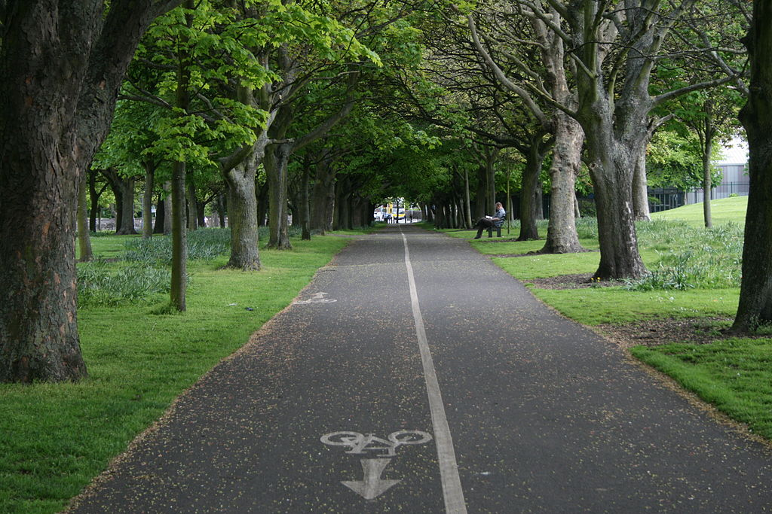
What about Ireland?
The next major development was in 1983.
Over the summer of 1982, many gay and bisexual men were beaten in homophobic attacks in Dublin.
On the 9th September 1982, a young man called Declan Flynn was beaten so badly, he later died.

Slide 19
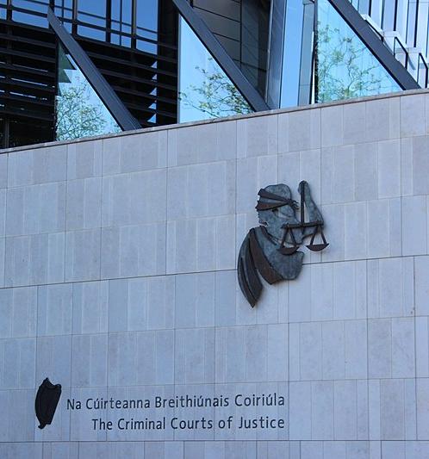
What about Ireland?
Despite two of the five assailants admitting to Gardaí that they had deliberately attacked around 20 LGBT+ people over the period of six weeks, all five were released with suspended sentences.
A suspended sentence means they would not have to go to jail unless they did something else wrong.

Slide 20
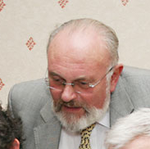
What about Ireland?
At the same time, a man who had stolen a purse was sentenced to 12 months in prison.
The judge in the Flynn case said that ‘this could never be regarded as murder’ and that there was ‘no element of correction’ required for the men.
LGBT+ people were very worried by the outcome.

Slide 21
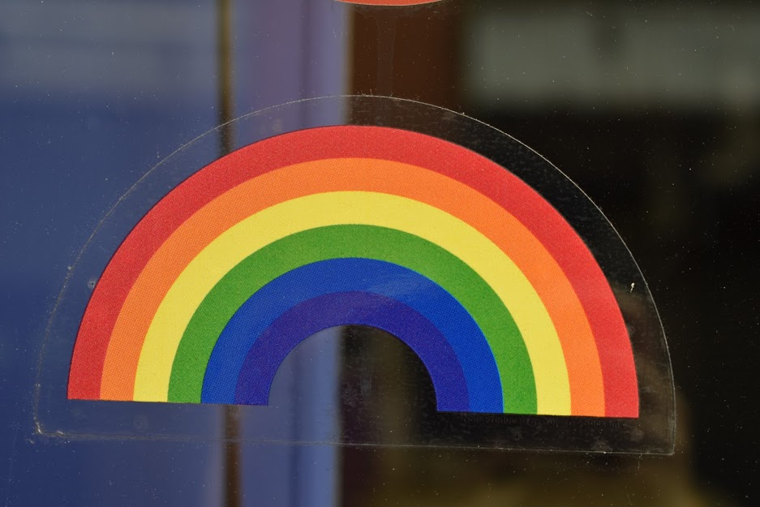
What about Ireland?
It resulted in the largest demonstration to date for LGBT+ rights.
On Saturday 19th March 1983, following the judgement, hundreds of people marched from Liberty Hall to Fairview Park (where Declan had been killed).
That June saw the first Pride Parade in Dublin city centre.

Slide 22
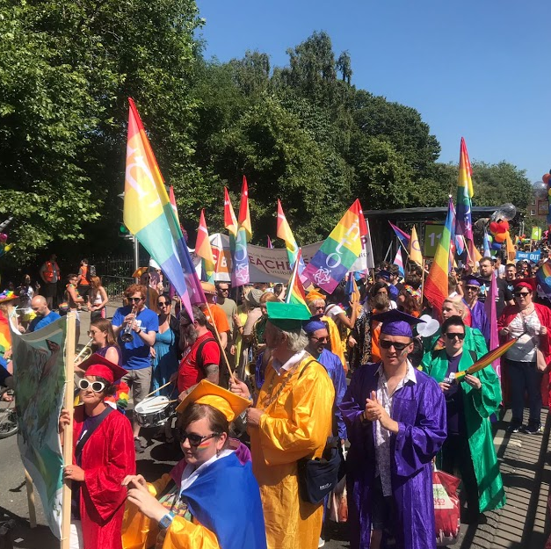
What about Ireland?
Since then, Dublin Pride has gone from strength to strength and tens of thousands of people attend every year.
Dublin Pride is the second biggest festival in the capital (after St Patrick’s Day).
There are now Pride parades in cities and towns all around Ireland.

Slide 23
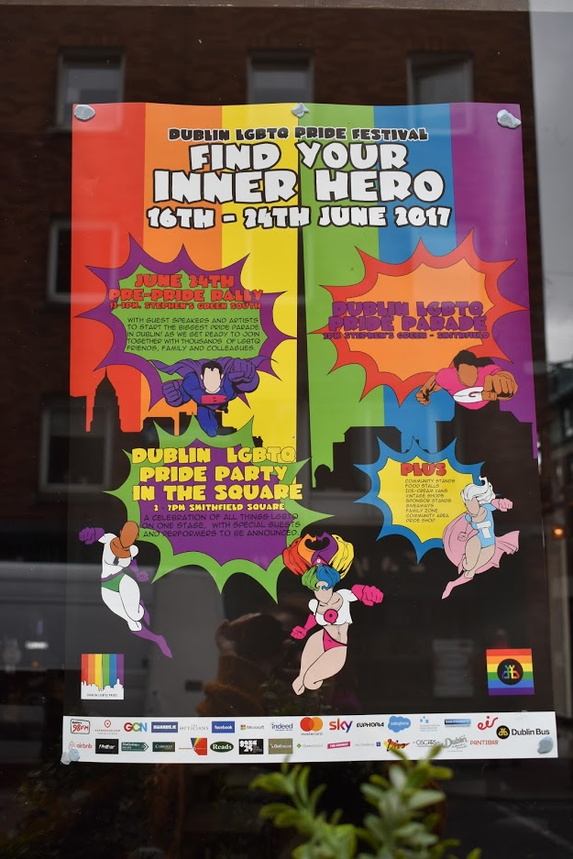
What about Ireland?
Despite the advances that have been made in LGBT+ rights over the years, LGBT+ people still face discrimination in society.
Consequently Pride remains as an important part of the annual calendar to remind us all that diversity is our strength and the everyone should be treated equally.

Slide 24
Enquiry Questions
How did it feel to be an LGBT+ person in the 1960s?
What changes have happened with regard to LGBT+ rights between the 1960s and now?
Given that LGBT+ people were not well respected at the time, was it braver for the LGBT+ people or the non-LGBT+ people to join the protests for LGBT+ rights in 1983?
What would I have done?
Is Pride still significant? Why/why not?

Slide 25
Self Assessment: I learned to…
Define some key vocabulary related to LGBT+ identities
Identify the origins of the first Pride in the world
Describe the origins of Pride in Ireland
Explore the ways in which attitudes and beliefs have changed since the 1960s
Discuss the continued importance of Pride as an annual event

Slide 26
Images Attribution
https://commons.wikimedia.org/wiki/File:Stonewall_Inn_1969.jpg#/media/File:Stonewall_Inn_1969.jpg Diana Davies, copyright owned by New York Public Library / CC BY-SA (http://creativecommons.org/licenses/by-sa/3.0/)
https://upload.wikimedia.org/wikipedia/commons/e/e1/Pride_March.jpg by Jay Paul / CC BY-SA (https://creativecommons.org/licenses/by-sa/4.0)
By 1-555-confide (talk) - Own work (Original text: self-made), CC BY 3.0, https://commons.wikimedia.org/w/index.php?curid=15852592
By Eoghan888 - Own work, Public Domain, https://commons.wikimedia.org/w/index.php?curid=19219417
By Metro Centric - Dublin, CC BY 2.0, https://commons.wikimedia.org/w/index.php?curid=85071781
By Lapsed Pacifist, CC BY-SA 3.0, https://commons.wikimedia.org/w/index.php?curid=3296964

