Slide 1

Youth Conference
24/25 March 2017
Silversprings Hotel, Cork
Sheila Nunan
General Secretary

Slide 2
Who are we?
Biggest teacher union: 43,425 Members North & South
Oldest Teacher Union
In every town and village on the island of Ireland

Slide 3
What we do!
Sole negotiating rights
Unite & organise
Safeguard & improve conditions & pensions
Afford advice & assistance
Promote the interests of education

Slide 4
2007 - 2017
Responding to the crisis and the emerging recovery
A decade of recession

Slide 5
2007 - 2017
Priorities/Policy
Strategies
Campaigns

Slide 6
Securing Teaching Jobs
Cuts to Public Service employment
320,000 in 2000
290,000 in 2015

Slide 7
unemployment
(Central Statistics Office (CSO) Website)
 | Live Register
Dec 2007 | 170,400
Dec 2008 | 290,000
Dec 2009 | 413,500
Feb 2017 | 275,093

Slide 8
Campaigning for
Teaching jobs
large schools – improvement in schedule
small schools – reversal
disadvantage – reversal
special education – 1 : 4
Campaigning & Lobbying
Class Size

Slide 9

“Fine Gael used focus groups to test the kite-flying proposals and the primary PTR came back very strongly”.
The u-turn would be a welcome decision for some, particularly in the INTO, one of the country’s most effective lobbying machines.
FROM: An Education: how an outsider became an insider – John Walshe (Minister RQ advisor), 2014. (Quote from the diary of Ruairí Quinn)
Budget 2011 proposal
28 : 1
30 : 1
Increase class size by 2

Slide 10
How other public sector areas fared
Nursing
39,006 – 35,330
Loss
- 3,676
(INMO Submission to PSCP : Figures Dec 2007 – Nov 2015)
Gardaí
14,500 – *12,850
Loss
- 1,650
(*As at 30 Sept 2016)
Primary Teaching
29,645 – 35,585
Gain
+ 5,940
(Figures: Dec 2008 – Feb 2017)

Slide 11
Teacher Supply
Under-supply
Over-supply

Slide 12
Good news!
Not an April Fool!!
€1,000 for everyone in the Audience

Slide 13
salary
FEMPI Legislation
Croke Park Agreement
Troika Bailout
Terms & Conditions
Reduction in new entrant pay
Allowances
Review
2 Cuts
Pay & Pension
12 – 15%
2010–14
€85bn
16 Dec 2010 – Dec 2013
Abolition
- 10%
Guarantees

Slide 14
Where are we now?
Project Team Report
Equalised upper points
Restored qualifications allowances in full
Increased starting point

Slide 15
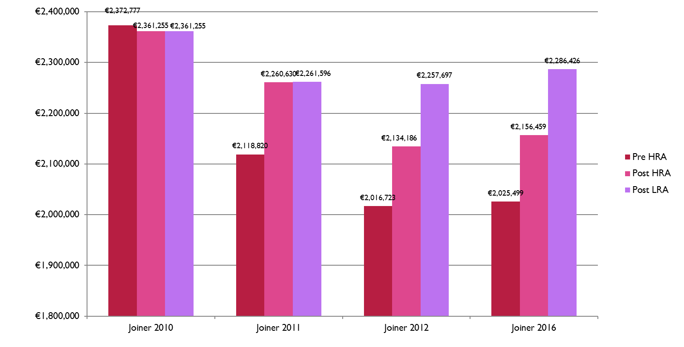
Pay Equality

Slide 16
Pay Deals
Next Steps!
INTO Priorities Pay Equality Road map out of FEMPI Benchmarking
Next Pay Talks

Slide 17
Professional
Restoring Posts
Commencement of restoration of posts
Selection process
Rewarding up-skilling
Support for CPD
Support for Study
Influencing the Profession
NCCA
Teaching Council
Colleges of Education
Professional Development

Slide 18
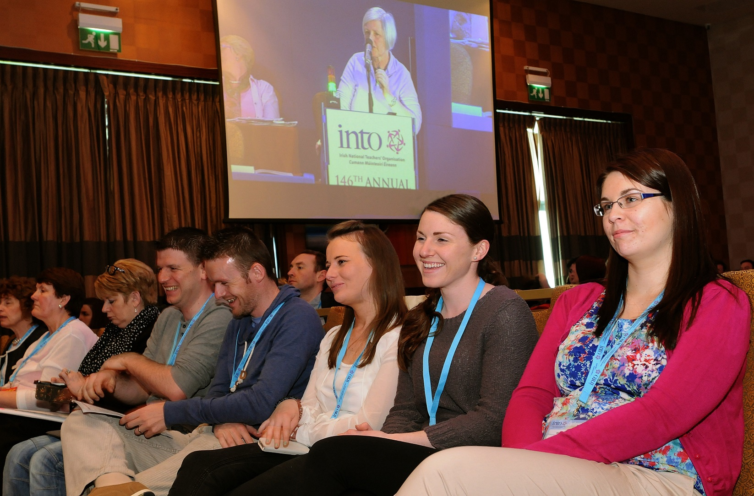
Participation
Participate
Actively Engage

