Slide 1
Managing Workload Conference Context
Deirdre O’Connor
INTO Assistant General Secretary
INTO Principals’ and Deputy Principals’ Committee

Slide 2
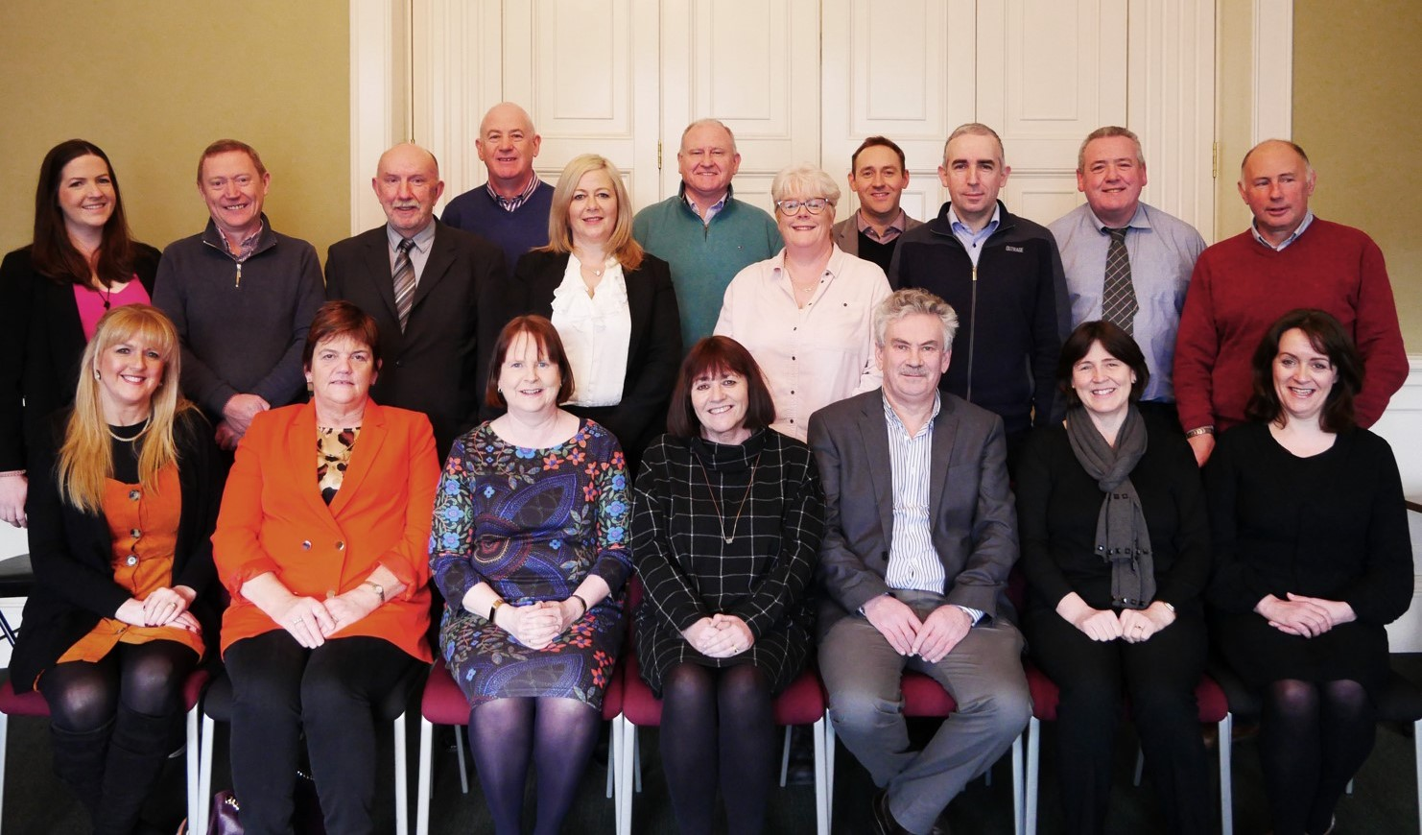

Slide 5
System
School
Self

