Slide 1
Sharing Good Practice

Slide 2
Orla O’Shea
Knockavilla NS,

Slide 3
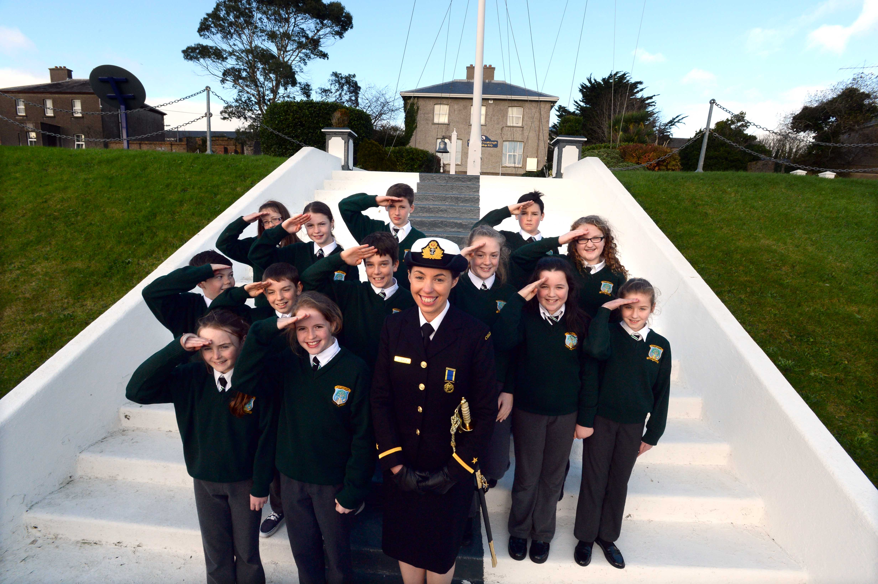

Slide 4
Angela Dunne
Loughmore NS, Tipperary

Slide 5
Presented by: Angela Dunne, Principal Loughmore NS September 2019
North Tipp ASD Class Forum

Slide 6
The North Tipperary ASD Special Class Forum
Schools
It’s a cross-service effort.
NCSE
HSE / Enable Ireland

Slide 7
The North Tipperary ASD Special Class Forum
Members of the Forum:
Two SENOs from NCSE.
Members from Child Development Team (HSE & Enable Ireland).
Principals & ASD Class Teachers from the 18 schools.
Facilitator from Child Development Team.

Slide 8
The North Tipperary ASD Special Class Forum
The Forum is not a decision-making body,
but it informs the decisions that schools make.
It is not a training venue,
but it supports shared training opportunities.
It is not an advocacy group,
but it inspires advocacy for our communities.

Slide 9
The North Tipperary ASD Special Class Forum
“The local Network we have established has meant no one is isolated in their schools and there is always someone to call on for clarity, advice, ideas or just a chat.”

Slide 10
North Tipp ASD Class Forum
Contact:
NTASD SpecialClassForum@gmail.com

Slide 11
Sharon Dunne
St. Sylvesters NS, Malahide

Slide 13
Maire Ní Mhanúsa
Letterkenny ETNS

Slide 14
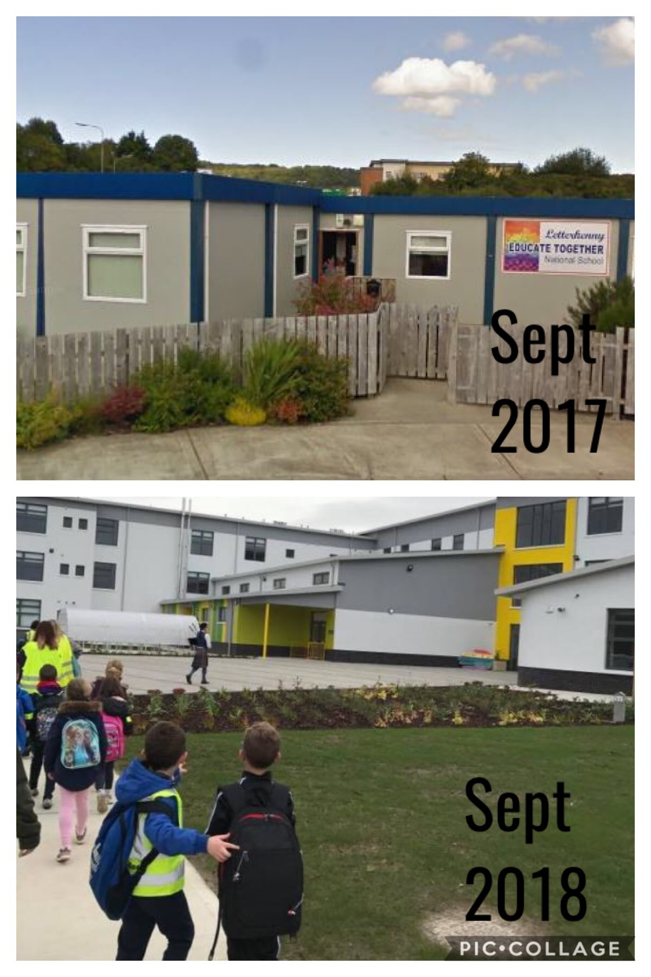

Slide 15
Feargal Hurley
Farranree NS Cork

Slide 16
Moyna Staunton
St. Mary’s Special School, Delvin

Slide 18
TITLE
Web: into.ie | Twitter: @INTOnews
Facebook: INTOnews | Instagram: into_news

