Slide 1
September 30th 2023

Slide 2
Workshop Agenda
NCSE
Context, Re-structure and Regions
Support
Professional Learning & Behaviour
Process
SER, a New Methodology
INTO
Inform us

Slide 3
NCSE Operating Context
Since 2011 there has been:
81% increase in SNA numbers
40% increase in SET numbers
386% increase in the number of special classes
117% increase in applications for transport and AT
Current prevalence rate for autism is estimated at 3.11%

Slide 4
NCSE Strategic Workforce Planning
Workforce Profile Overview(Projections)
The above data for illustration purposes only

Slide 5
NCSE Strategic Workforce Planning
Percentage Volumes by County
% Volumes by County*
Population by County*
County | Total number of applications 2021-2022 (Average)
Dublin | 22.8%
Cork | 20.5%
Galway | 4.7%
Kildare | 5.0%
Kerry | 4.2%
Meath | 4.4%
Louth | 4.3%
Limerick | 3.5%
Wicklow | 3.5%
Tipperary | 2.1%
Mayo | 1.6%
Wexford | 3.2%
Roscommon | 1.3%
Clare | 1.7%
Sligo | 1.4%
Waterford | 1.7%
Offaly | 1.6%
Laois | 1.6%
Donegal | 2.6%
Westmeath | 1.4%
Kilkenny | 1.3%
Carlow | 1.0%
Cavan | 1.8%
Monaghan | 1.3%
Leitrim | 0.6%
Longford | 0.8%
County | Population by County | Percentage of Irish Population
Dublin | 1,450,701 | 28.31%
Cork | 581, 231 | 11.34%
Galway | 276, 451 | 5.4%
Kildare | 246, 977 | 4.82%
Kerry | 155,258 | 3.03%
Meath | 220,296 | 4.3%
Louth | 139,100 | 2.71%
Limerick | 205,444 | 4%
Wicklow | 155,485 | 3.03%
Tipperary | 167,661 | 3.27%
Mayo | 137,231 | 2.68%
Wexford | 163,527 | 3.19%
Roscommon | 69,995 | 1.37%
Clare | 127,419 | 2.49%
Sligo | 69,819 | 1.34%
Waterford | 127,085 | 2.48%
Offaly | 82,668 | 1.61%
Laois | 91,657 | 1.79%
Donegal | 166,321 | 3.25%
Westmeath | 95,840 | 1.87%
Kilkenny | 103,685 | 2.02%
Carlow | 61,931 | 1.36%
Cavan | 81,201 | 1.58%
Monaghan | 64,832 | 1.27%
Leitrim | 35,087 | 0.68%
Longford | 46,634 | 0.91%
*Source: 2022 Census

Slide 6
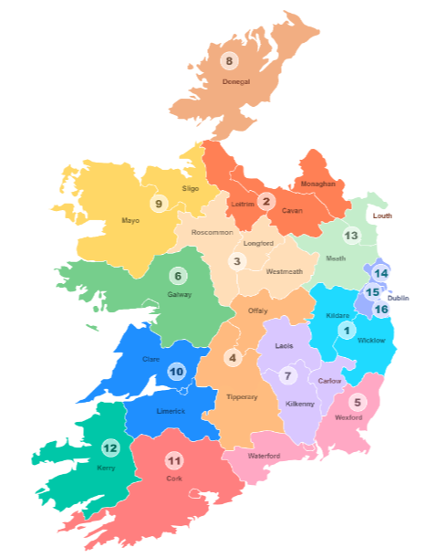
Regional Breakdown – Proposed
Regions | ID | Sum of Number of schools | Schools per km2
Kildare / Wicklow | 1 | 243 | 0.07
Cavan / Monaghan / Leitrim | 1 | 205 | 0.04
Longford / Roscommon / Westmeath | 1 | 235 | 0.04
Tipperary / Offaly | 1 | 265 | 0.04
Waterford / Wexford | 1 | 220 | 0.05
Galway | 1 | 276 | 0.04
Kilkenny / Carlow / Laois | 1 | 220 | 0.05
Donegal | 1 | 203 | 0.04
Mayo / Sligo | 1 | 263 | 0.04
Clare / Limerick | 1 | 298 | 0.05
Cork | 2 | 440 | 0.06
Kerry | 1 | 161 | 0.03
Louth / Meath | 1 | 233 | 0.07
Dublin | 3 | 696 | 0.75
Grand Total | 17 | 3958

Slide 7
A Structure to Deliver
Student
Sensory
National
Teams
Therapy
Curriculum
TPL and PD
Autism and Behaviour

Slide 8
Researchers suggest that effective PD…
is intensive and ongoing,
focuses on content knowledge and student learning,
aligns with other learning activities and school improvement goals,
provides opportunities for active learning on the part of teachers,
develops strong working relationships among teachers,
is job-embedded,
includes coaching and performance feedback
(Darling-Hammond et al., 2009; Darling-Hammond et al., 2017; Desimone, 2009; Garet,Porter, Desimone, Birman, & Yoon, 2001; Yoon, Duncan, Lee, Scarloss, & Shapley, 2007).
Notes:
Just some of the key elements highlighted as important for TPL

Slide 9
Three Modes of “CPD”
Transmission
Transformative
Transactional
(Miller, 2007)
Notes:
helpful to think about how clusters and follow on supports are really helping us create more opportunities for transactional and transformative learning
Less about us having to have all the info to give, more about create opportunity to engage with information and connect it to own prior knowledge and experiences through interaction, dialogue and collaboration with other teacher.

Slide 11
Who is the Behaviour Framework for?
Primary, Post-Primary and Special Schools
Leadership teams identifying staff capacity needs
Class Teachers and SET Teachers supporting a student
Who is working on it?
Staff from Behaviour, Autism and Curriculum teams as well as a speech and language therapist and occupational therapist.

Slide 12
So far, consultation has included:
NAMBSE
Inclusion Ireland
TESS
AsIAm
School Leaders and Teachers
With more to come!

Slide 13
Principles Underpinning every step
Rights Based
Student Voice
Inclusive
Regulation
Neuro-affirmative
Strengths based – solution focussed
Universal design
Unconditional Positive Regard

Slide 14
A Six Step Framework
Knowing and Understanding
Building Relationships
Gathering More Information
Creating Supportive Environments
Reviewing and Responding
Teaching and Supporting
Inclusive
Holistic
Practical - Toolkit
Proactive
Promotes universal approaches
Resourced at every step
Builds teacher confidence
Links to the CoS and Support Plans

Slide 16
SER – 2021 and 2022

Slide 17
NCSE CONSULTATION - SER PROCESS
Staff
Conferences
School
Visits
Representations
Formal
Reports

Slide 18
DEMING – TQM GURU

Slide 19
TQM - SHINGO

Slide 20
DEMING – TQM GURU

Slide 21
Total Quality Management
Organisation wide continuous improvement
…. a management process
…. an integrated approach
…. an organisational culture
…..a strategy
…..a co-ordinated Mind-set

Slide 22
TQM – A Process Huddle

Slide 23
Pfizer – A Shingo Success Story

Slide 24
NCSE – TQM

Slide 25
TQM
Leadership commitment
Organisational Culture
Systems and processes
Continuous improvement
Staff participation and Development
Student and School focus
Stakeholder engagement
Leadership commitment
Organisational Culture

Slide 26
Application of TQM to SER Process
Focus Groups
Primary Principals (INTO)
Primary Deputy Principals (IPPN)
Special School Principals (SMH)
An Foras Patrunachta

Slide 27
Application of TQM to SER Process
What your experiences and viewpoints as school principal of the NCSE SER process?
What was the quality of your engagement with NCSE staff during the SER process?
Do you believe the SER process is focused upon supporting students?
What was the administrative workload associated with the SER process?
How can the SER process be improved?

Slide 28
Principles of Process Mapping
Waste, Overburden & Pressure
Everyone in the room
Customer Value
Walk the Process

Slide 29
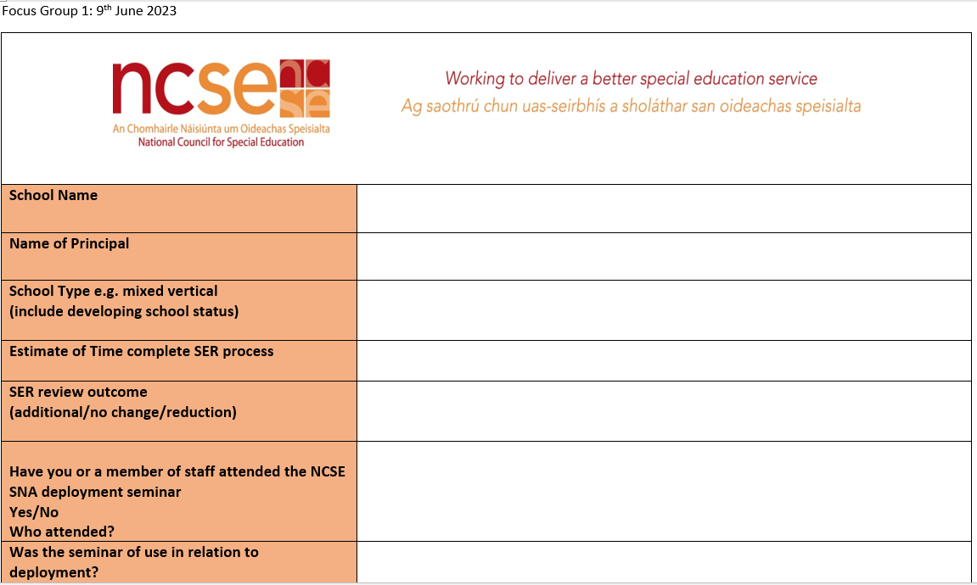
Process Mapping for the SER Process

Slide 30
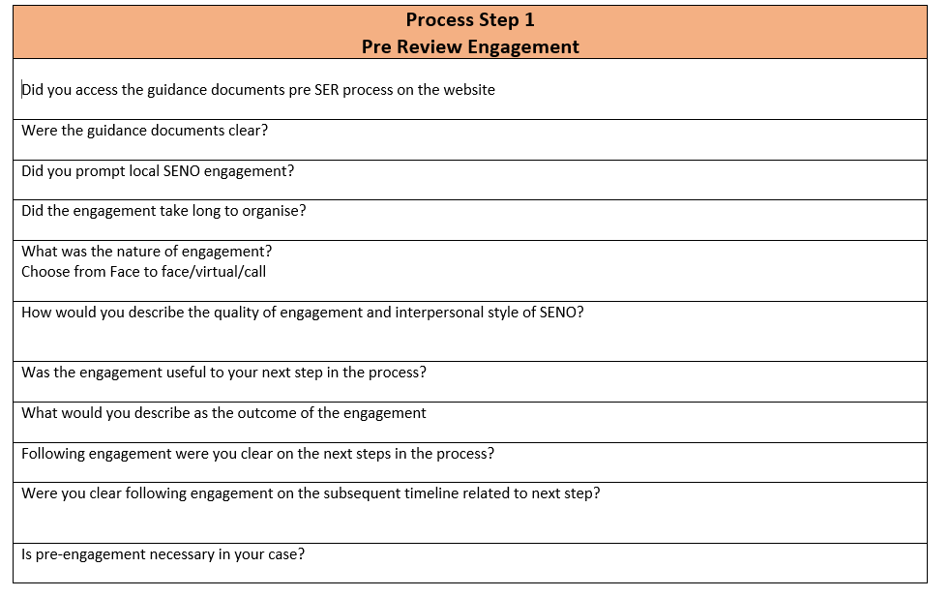

Slide 31
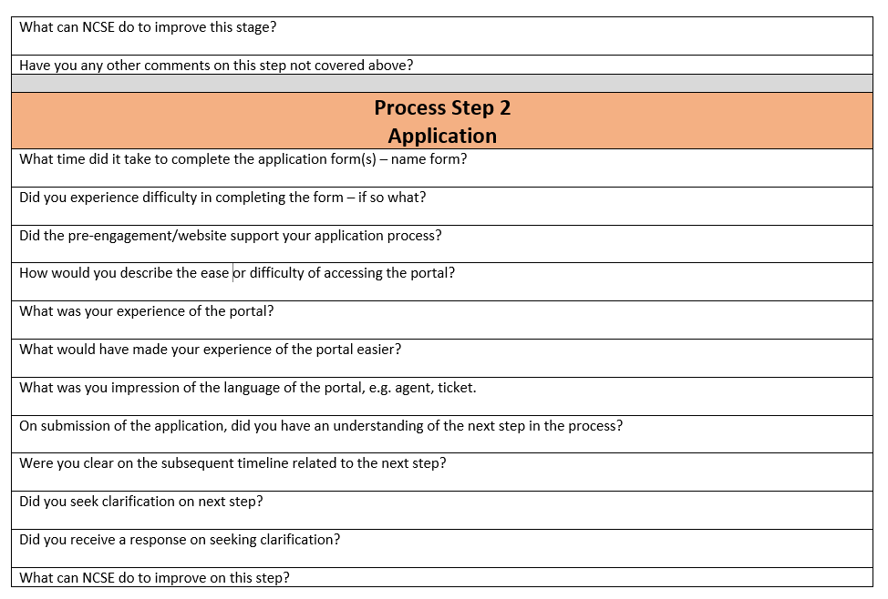

Slide 32
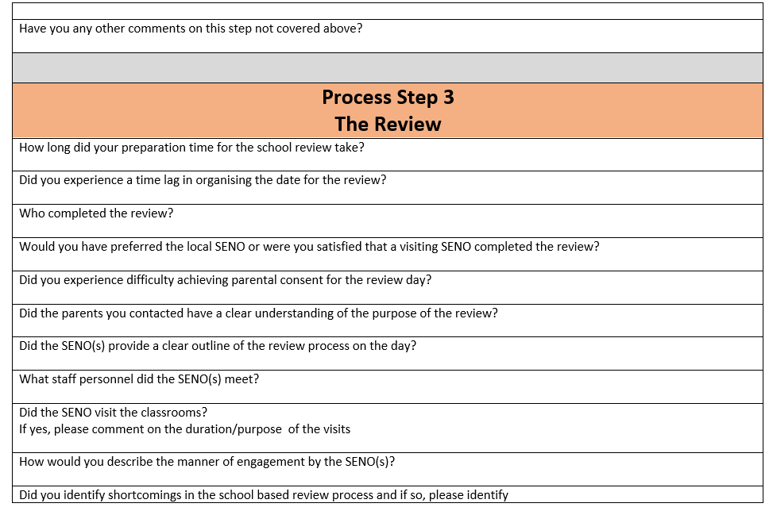

Slide 33
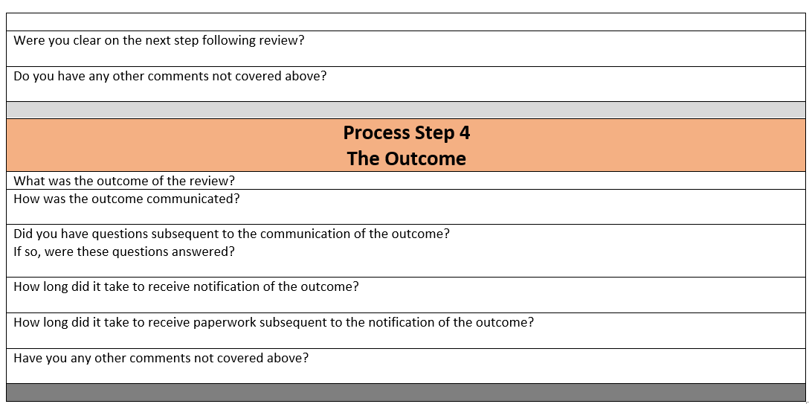

Slide 34
INTO Principals Focus Group
what you told us……

Slide 35
Former System
In days of old like that the SENO called there would be a pre planned Meeting. The SENO would be familiar with all the children in the school. And at the start maybe I was perplexed as to why they called to see the children. I sort of maybe being conspiratorially minded, why would they want to go around to see the children. Is it what I'm saying is true, but then I actually found it was actually a good thing to bring them around to show them the settings where the children are and also give them an opportunity to even say hello to the class Teacher from time to time and acknowledge the work that they're doing. It was a great relationship because it also worked well form a transitional point of view when children from our classes were transitioning from setting to another.

Slide 36
CORE SERVICE

Slide 37
Trust in Principal - Trust in SENO
The Review was not looking at the children, and I go back to the old system and the SENO would come. He would observe it. He would do a full evaluation and then he would say to me yes or no and you accepted it because you trusted him. And he trusted me. The exception review was all about paper, paper, paper, paper. And we spoke about the process as a staff afterwards and quite honestly we were gobsmacked with the process

Slide 38
Trust in Principal - Trust in SENO

Slide 39
Paperwork
Imagine creating timetables for 10 staff and then creating a possible timetable for 12 staff for imaginary children. The challenge of that in order to get what you know and when. That's exactly what we do, mental torture.

Slide 40
Administration Timelines

Slide 41
SERC for Special Schools
I suppose that we all feel that this whole SERC model needs to be reviewed. You know that it's not fit for purpose. Our needs have developed so much because of the complexity of the people that we're now supporting. And that we need so much more than the SERC allocates and all the special schools here have kids with very, very complex autism. And with that comes a lot of challenges around behaviour management, and kids with psychiatric needs as well. And so our schools really support the kids that could not cope in other settings and years ago would have been in institutions and would be highly supported. So we have those needs in our schools and it's very extreme.

Slide 42
SERC for Special Schools
I suppose that we all feel that this whole SERC model needs to be reviewed. You know that it's not fit for purpose. Our needs have developed so much because of the complexity of the people that we're now supporting. And that we need so much more than the SERC allocates and all the special schools here have kids with very, very complex autism. And with that comes a lot of challenges around behaviour management, and kids with psyhiatric needs as well. And so our schools really support the kids that could not cope. In other settings and years ago would have been in institutions and would be highly supported. So we have those needs in our schools and it's very extreme.

Slide 43
Behaviours of Concern
The complexity of the student is the other piece, the role of the SNA and then the staffing in that context.. to acknowledge you're going to have people who are out because of the complexities of behaviour. I regularly have eight members of staff who are actually out on a continuous basis and then I have to try and ensure that progression still happens for the students

Slide 44
Behaviours of Concern

Slide 45
Service Systems | Current System Former System | SERC for Special Schools Former System Website Access
Core Service | Reliability Responsiveness Assurance Communication | Consistency Special School Emerging Need Developing Schools Recommendations
Relationships | Principal SENO Staff SNA | Trust in Principal Trust in SENO Pressure on SNAs during the process Understanding of SNA Role
Student Focus | Student Observations | Student Observations Behaviours of Concern Frequency in Special Schools Fire fighters or Fire Wardens
School Burden | Administration Planning | Timelines Paperwork Forward Planning Consistency Rationale / Recommendations

Slide 46
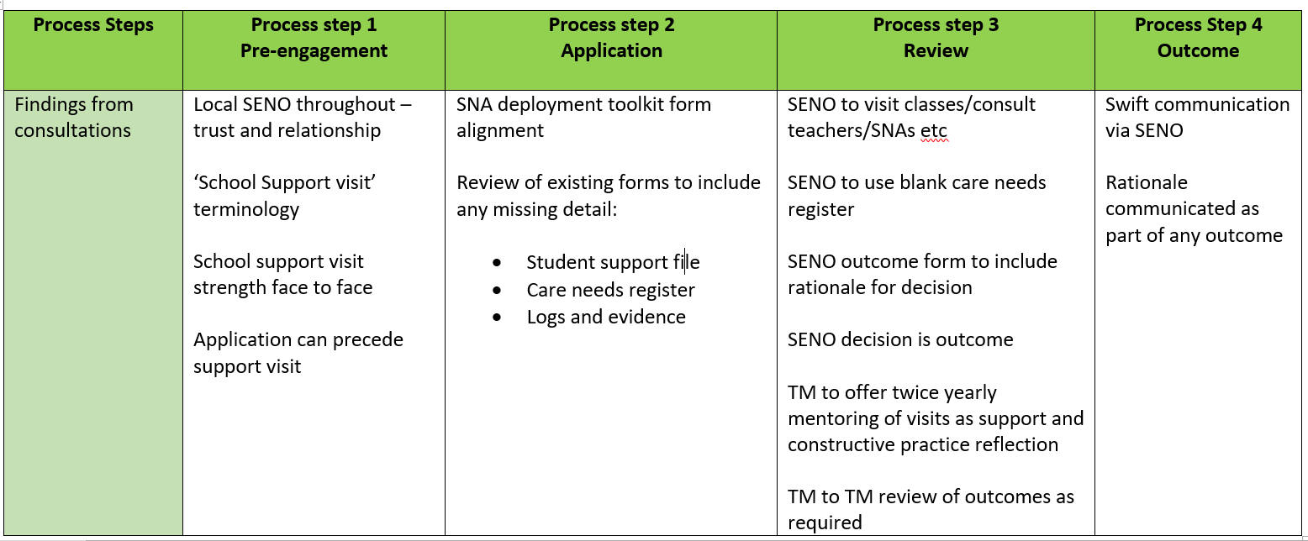

Slide 47
Collaborative Partnership

Slide 48
Over to you…..
1. What are the greatest professional learning needs in your teaching community?
2. What service does your school need from the NCSE SENO/VT/Advisor/Therapist/Administrative Supports?

