Slide 1
INTO Conference 2016-
Gender and Career Progression in Primary Teaching:
The framing of gender inequality and how we read it.
Dr Maeve O’Brien, St Patrick’s DCU
Notes:
Introduction
Welcome,
I want firstly to express my own interest in the theme of the conference-reflecting on my own history professional/personal. I have been a Teacher, equality committee member , teacher educator, researcher and parent. Drawing on this and in preparation for the talk today I have recognised some of myself in the gender and career/work issues as a woman. The literature I have been reading in preparation for today, has again become a powerful motivator to articulate and problematise some of the assumptions around, gender, teaching and how we think about progression and leadership roles.….
2. So I want to question the framing of the problem in terms of the issue gender and of equality.
How do we understand inequality in progression?
This is part of a bigger question that encompasses not just a focus on the numbers of men and women in the positions they occupy, it is also to do with their experiences of these and their satisfaction with their work. And it is also about the hard realities of status and economics. So on the one hand it is important to speak to the empirical research and the data we have or not in relation to the numbers who progress and who don’t but also about pathways and motivations and how these teachers arrived there, how it has been for them as successful applicants or as teachers who have never put themselves forward and never will go for promotion!
Contexts are everything, and so as we focus on this issue today, it is against a backdrop of the moratorium on promotions, Irish society and its traditional values, the historical reality of the management of primary schools, Irish culture and gender, in other words traditional views around roles and identities. It is also explored here in awareness of the serious issue of the capping of teachers pay more generally and at entrance to the profession in particular (nurses protests)

Slide 2
Overview and Key Issues
Broad context- Gender and Career per se, women’s vs men’s place in the labour market and unpaid labour. Not just about numbers in positions and sectors....quality of the experience
Teaching context -Myths and moral panics around ‘male’ shortages in school teaching-the reframing process…
Data- National and international, data the lack of data in Ireland, …a leadership discourse that is often gender blind
Barriers to progression: formal and informal, school and the wider context
The ‘Mommy Track’ in the labour market and our understanding of gender roles, the glass ceiling
Why? Explaining gender inequality-Understandings of our identities and -the patriarchal order, the heterosexual matrix and issues of work life balance, roles and identities
Implications for policy in education, for education at ITE, CPD, for classroom practices

Slide 3
Public Discourse- ‘Moral Panic’ and the feminisation of teaching as a profession
Research in Ireland and elsewhere raises the issue of gender imbalance ie a lack of males in teaching vs a vis females as problematic
Is this a problem? And if it is for what reason?
-Role models for boys (Connell The Men and the Boys’)
-Access to teacher education- boys’ academic achievement suffering …not enough role models
-Discipline and authority …males seen to be more authoritative
-Masculinities and Femininities ( a contested terrain)
Notes:
A debate and what has become ‘the gender debate’ has been taking place for at least a decade in Europe and beyond, over the perceived underachievement of boys and young men....., a debate which many feminists scholars suggest distracts from the persistent inequalities within the teaching profession itself, on wider inequalities in society and focuses on the problem – constructs it in reality as a consequence of a lack of men, thus the feminisation of the teaching force is viewed as the big equality problem ie the education of young people boys, ‘poor boys’, failing boys and that things be better if there were more men and male role models. This claim is not of course based in any evidence but the assumption they boys need male role models to identify with. The almost then provides a justification for having more males in positions of authority in teaching, a kind of balancing up the see say of gender inequality.
Based in (The Gender Delusion- as critiqued by Cordelia Fine. Fine presents evidence from neuroscience that refutes these biological pseudoscientific claims about the wiring of men and women’s brains). The issue of men providing more discipline and authority is again unfounded but often has mythical status and may appear in teachers’ own discourses because of stereotyping and social norms (Moreau and Osgood 2007).

Slide 4
A Need for Clarity in conceptualising a gender in/equality problem in career progression
Discourses around a feminised profession and the problematic myth of male absence
How we think about gender equality more broadly-is it about equal numbers of the genders or about how we understand gender in its complexity as a social construction that reflects traditional and dominant views around human identity. (equal opportunity and affirmative approaches)
Leadership discourse and research as unconcerned with gender problems (except see Morgan and Sugrue 2005) Hegemonic masculinity!
Notes:
Reality of a feminised work force is low status and low pay that may continue to deter men from entering teaching Drudy 2008.
alongside issues around ‘professionalisation’ which requires more technical scientific knowledge and less care. Rational systems of output and production….rather than more traditional and what are often seen as less sophisticated approaches to T and L, anything embodied and nurturing cannot be measured and therefore does not count for professional practice.

Slide 5
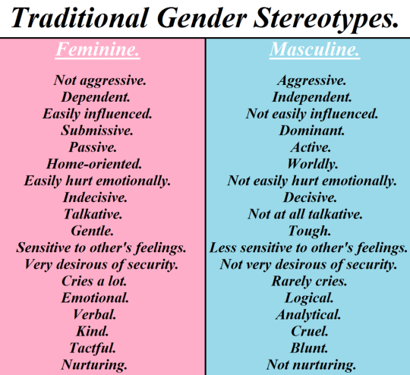
Gender stereotypes-Implications for the workplace and leadership?
Notes:
In a British national study by Thorton and Bricheno (2000) of teachers Primary School Teachers’ Careers in England and Wales….48.1 % of M achieved headships and 16.1% of F and is associated with higher salaries.
Career intentions of M and F 80% F on lowest quals were not seeking promotion vs only 50% of M on same grade not…and other 50% looking outside teaching….
F with higher degrees 46% definitely not seeking promotion and 0 Males with a higher degree NOT!

Slide 6
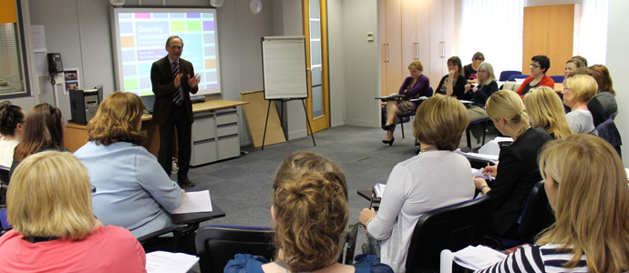
The Significance of Gender and Gender Inequality in Education- a web image from a BA in early childhood education and training!
Notes:
Why don’t we see the problem as a problem?

Slide 7
Gender Differences are seen in how teachers are positioned-a) Levels in System, b)Subject Areas and c)Promoted/Leadership positions
Issue A): N Irl. - Teachers in schools by gender 2008/2009
 | Male | % of males | Female | % of females | ratio | total
Nursery | 0 | 0 | 214 | 1% | 0 | 214
Primary | 1,328 | 26 | 7299 | 48 | 5.5 | 8627
Secondary | 2,055 | 40 | 44332 | 28 | 2.16 | 6387
Grammar | 1,584 | 31 | 2728 | 18 | 1.7 | 4312
Special | 154 | 3 | 669 | 4 | 4.3 | 829
Totals | 5,121 | 100 | 15242 | 100 | 3.0 | 20363
Pay differentials by sector!!
Notes:
What is or has been the status quo, what do we know from the available research? Firstly there has been a moratorium in Irl so that has created a certain stagnancy and frustration for all. The promotion system in teaching in Irl shows however significant differences by gender and level, subject areas taught and who attains and applies for leadership positions. There are no surprises, you can guess how it goes. The problem however is that we can take certain kinds of difference for granted so it does not count as an inequality while others seem more justifiable as problematic. The idea of what is natural for women and men teachers and what suits them becomes understood as a personal choice! Women prefer teaching younger children and are more motherly, and so forth. Men are more authoritative than women and boys need this…..Ideas like this that attain a legitimacy though they mask structural inequality and ideological positions.

Slide 8
Issue C) Leadership stats indicate a gender difference
NI School Principals, Source: Teachers' Pensions, Pay and Administration Branch, Department of Education (June 2009)
 | Principals no. | % | Vice Principals no. | %
Male | 553 | 46.3 | 295 | 35.2
Female | 641 | 53.7 | 542 | 64.8
Total Associated pay differentials-higher average pay for males | 1194 | 100 | 837 | 100
Notes:
Not just a matter of status equality but ALSO of pay. Pat O Connor’s work on Emerging Voices captures this so well. It is interesting when I searched the leadership articles and scholarship that the focus is often and we can see why..on how to be a good principal, the stresses of leading and teaching and not on who gets the position. Little preparation, 2016 article in IES by Umazel and McNamara on the lack of preparation and others…

Slide 9
Principals and Teachers at School Levels ROI
Gender and Promoted Posts (DES 2012)
Gender and Teaching force (CSO 2013 and 2007)
Principal
F M
65% 35%
Assistant Principal
F M
95% 15%
Fall in promotions overall through
moratorium 2012 to 2015
43% to 40%
All teachers 75% F
Primary Level Teachers 85% F
Primary School Managers 44% F
Second Level Teachers 68% F
Notes:
Discrepancy in figures is due to different definitions of managers

Slide 10
2nd level Principalship and Deputy P by gender and sector DES (2005)
Total Sec and C and C Total Sec Total C and C
M F M F M F
67.3% 32.7% 64.1% 35.9% 80.4% 19.6%
Deputy/Vice principal
57.8% 42.2% 58.4% 41.6% 55.5% 44.5%
Assistant Principal/A Post
49.7% 50.3% 48.7% 51.3% 53.1% 46.9%
Special Duties/B Post
35.6% 64.4% 35.0% 65.0% 37.7% 62.3% Special Functions
57.1% 42.9% 80.0% 20.0% 0.0% 100.0%
TOTAL
43.5% 56.5% 42.7% 57.3% 46.2% 53.8%
Data Source: Department of Education & Science, Payroll Division (Primary Substitution and IT Liaison), Athlone.
Ireland | 55.6 | 44.4 | 59.4 | 40.6

Slide 11
Explanations-
1. Connell’s Thesis of Hegemonic Masculinity
Dominant forms of being male-masculinity-Now revised to include the fluidity of gender identity, remodelling in relation to gender hierarchy, the agency of women, geography of masculinity, power and privilege
“Masculinities are configurations of practice that are accomplished in social action” (Connell and Messerschmidt, 2005)
Gender is relational and masculinities and femininities are enacted in relation to each other
Meuser (2003) while hegemonic masculinity may not be an accurate description of the daily practices of younger men, ‘‘its importance lies in being an interpretive pattern for locating oneself in the gender order.’’
In education-Theories of dominant and complicit forms of masculinity have implications for progression and leadership with respect to school cultures and management cultures (see Lynch and Lodge Equality and Power in Schools 2001)
11
Notes:
Leadership and the gendering of school culture are related, and this is exquisitely drawn in relation to students’ experiences in 2nd level single sex and co ed schools in older work e.g. Willis and Mac and Ghaill in UK and in Lynch and Lodge. The even mention the unmentionable which that not only do students on the basis of their gender suffer harassment but that women teachers also tell stories of sexual harassment by male students.

Slide 12
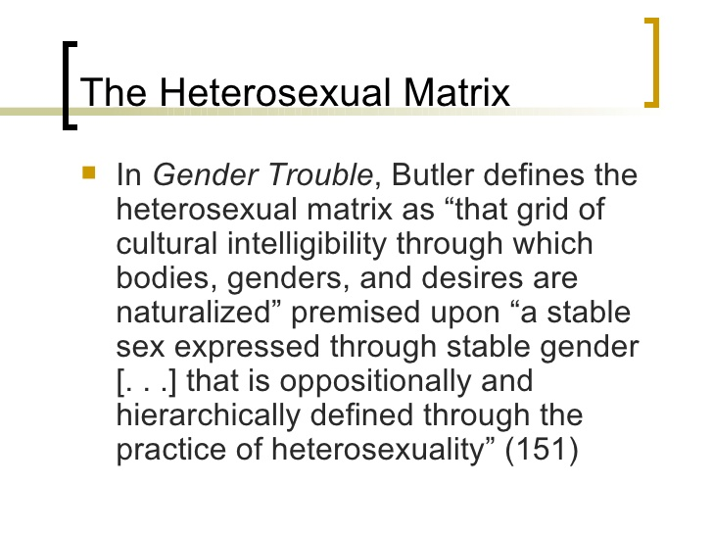
2. Naturalisation of Gender Differences-
J Butler
12
Notes:
Our gender and sexual identities are an aspect of our professional identities that may influence how we perceive ourselves in our roles and what avenues we know are opened or closed to us on the basis of culture as opposed to formal barriers

Slide 13
3. Identity-Familiar sounding, but it’s higher education in Canada e. g. (Armenti C. 2004)
Abstract- “research involved in-depth interviews with nineteen women professors, drawn from across various faculties and ranks at one Canadian university, and was intended to explore the interconnections between the women's personal and professional lives. The women in this study chose to combine having children with an academic career. Most of them depicted their career trajectory as a lifelong challenge, one that was both fulfilling and prestigious. In contrast, the women reported a number of obstacles in their career paths that served to prevent them from gaining full membership in academic life. This study probes the nature of such obstacles that are grouped into two categories: the child-related time crunch and the career-related time crunch. As a result of these obstacles, the women encountered childbearing/childrearing problems, research dilemmas, a willingness to leave the academy, and denial of tenure and promotion. Findings call for a restructuring of academic careers in order to effectively accommodate women with children in the profession”.
Notes:
My desk based survey of the literature across the sectors of education sounds some similar notes, although the locations and levels of education vary. I have gathered studies across Europe and NA and Africa where the issue of gender barriers for women are prevalent, and the explanations as to why women experience these barriers have some commonalities. Pat O’Connor is probably one of the most seminal empirical researchers in Ireland on this issue of sectoral positioning and barriers to progression, Kathleen Lynch on theorising inequalities from the perspective of care, love labour and gender. Some critique from post structural post modern thinkers on identity…..suggest men suffer inequalities and that the male/female conceptualisation of gender is problematic in itself.

Slide 14
4. The Naturalness of Male /Female Differences in roles and rewards!
Traditional perspectives on gender and role in the private/familial space reinforce gender barriers in the workforce relative to type of occupation, position and economic remuneration (Thornton and Bricheno 2000, UK national survey-intentions to seek promotion –lowest grade-F 80% not seek, M 50% not seek and differences at higher grades and across career duration, less conventional men…)
Hochschild’s work ‘The Second Shift’ a seminal work that is still borne out in research today
The rise of biological and scientific perspectives on sex differences
Notes:
What’s the Big Deal?
Everyone, it seems, is pointing out the innate differences between men and women lately: Louann Brizendine’s The Male Brain purports that men are simply less emotional than women; Leonard Sax has led increased calls for single-sex education to better cater to the different needs of girls and boys; even the World Economic Forum recently suggested that corporations are failing to capitalize on distinctly female talents. But isn’t that all just an excuse to keep inequities in tact? Perhaps. Because if men and women truly have different brains, shouldn’t we all just accept that it’s men who are hard-wired for jobs in engineering, politics, and science, and that women should—as Cambridge University psychologist Simon Baron-Cohen has put it—accept their place in the world of primary-school teachers, nurses, and social workers? Actually, no. Fine links brain psychology to persistent workplace inequities, which show what all this skewed thinking is costing women today.
Moreover the research on men as carers and engagement in caring work suggests that men can and with support will want to be involved in the more nurturing roles…HOPE! Men can be feminists and for equality.

Slide 15
5. Criteria for Promotion: The Irish Context and Primary Teaching, how are these understood in a traditional culture?
How objective are the criteria?
1) Length of service
2) Knowledge, understanding and capacity to meet the needs of the job
3) Capacity to contribute to the overall development of the school
4) Interpersonal and communication skills
5) Capacity to contribute to the overall organisation and management of the school
20 marks for each criterion
Notes:
Formal barriers? The criteria are agreed so as to remove possibilities of bias but take each one in turn and consider if it can be gender neutral. ..Research suggests that within management (criterion 5) culture that there is a bias towards more authoritative and masculine style. Qualitative research studies explain that Teachers feel this traditional view of management persists and that they will not be ass effective as leaders. They also talk about wanting to stay connected to teaching and students and that promotion to leadership will not be satisfying because it is less about people care (Moreau, Osgood et al 2007).
Drudy (2008) discusses in her paper the impact of feminisation on the status of teaching and the remuneration of teaching.

Slide 16
6. The Classroom Floor-
Women’s work- women seeing it as women's work!
Teaching at pre and primary levels is perceived as an extension of mothering and caring, low paid and low status work (Skeggs, Maguire and others)?
Masculinities and femininities: diversity and stereotypes of teachers at levels in the system and of managers and leaders
Serendipity discourse and women managers in education (M. This is also reflected in ITE research with teacher educators, irrespective of gender (O’Brien and Furlong 2015)
Notes:
Large body of research that explores various aspects of masculinities and femininities in education and that challenge traditional understandings and sociobiological approaches to gender. Emancipatory and equality perspectives

Slide 17
Conclusions
Identity and teachers understandings of themselves and their work with children-care and relationships
Cross cutting identities.. we don’t have a great deal of data on which teachers go for promotion relative to other dimensions of their identity, class and ethnicity and sexual identity. Gender has been the primary focus.
Reframing the inequality problem in terms of context, culture and identity
Dispelling myths and moral panics around males, teaching, leadership and student achievement
“an outrage there is not being more done to encourage males into the profession” Is this a cause for outrage?

Slide 18
Implications for Policy and Practice
The need for education around our gender identities that is critical and empowering at all levels- (Bubeck on Circles of care and women's identity)
The issue of consciousness raising among teachers and staff. (The low response rate to the INTO survey says something)
Reframing the problem-Equality and how it is understood.
A) Critiques of ‘equal opportunity equality’.
B) Middle class feminism
C) Our multivalent Identities and development and these effects on children’s education (hidden curriculum)
Further research and data needed- national study on career progression and satisfaction (Making a Difference)
Notes:
Bel hooks: “Imagine living in a world where there is no domination, where males and females are not alike and not even always equal, but where a vision of mutuality is the ethos shaping our interaction. Imagine living in a world where we can all be who we are, a world of peace and possibility. Feminist revolution alone will not create such a world, we need to end racism, class elitism, imperialism. But it will make possible for us to be fully actualized females and males able to create beloved community, to live together, realizing our dreams of freedom and justice, living the truth that we are all ‘created equal’. Come closer and see feminism…………. is for everybody”. (Feminism is for Everybody: Passionate Politics: 4).

