Slide 1

Teaching in the
Republic of Ireland
David O’ Sullivan
Assistant General Secretary
25 January 2022

Slide 2
Teaching Council
Registration
Vetting
Pre-Employment
Permanent
Substitute
Terms and Conditions
Pay
Leave
Fixed-Term
Pensions
Panel/CID
Social Welfare
Casual
Non-Casual
Vacancies
PPS Number
Revenue Commissioners
Irish Language Requirement

Slide 3
Teaching Council- Vetting
National Vetting Bureau (Children and Vulnerable Persons) Act 2012
School authorities will be required to obtain a vetting disclosure from the Bureau before commencing teachers and non-teaching personnel in employment in their schools (S.14)
DE Circular 31/2016
Retrospective Vetting and Re-Vetting
Recruitment
  Good practices
  Statutory Declaration Form
  Form of Undertaking

Slide 4
What is a vetting disclosure?
S.14 of the NVB Act
A vetting disclosure is a statement issued by the Bureau which sets out the particulars of the criminal record (if any) and/or a statement of the specified (soft) information (if any) relating to that person.

Slide 5
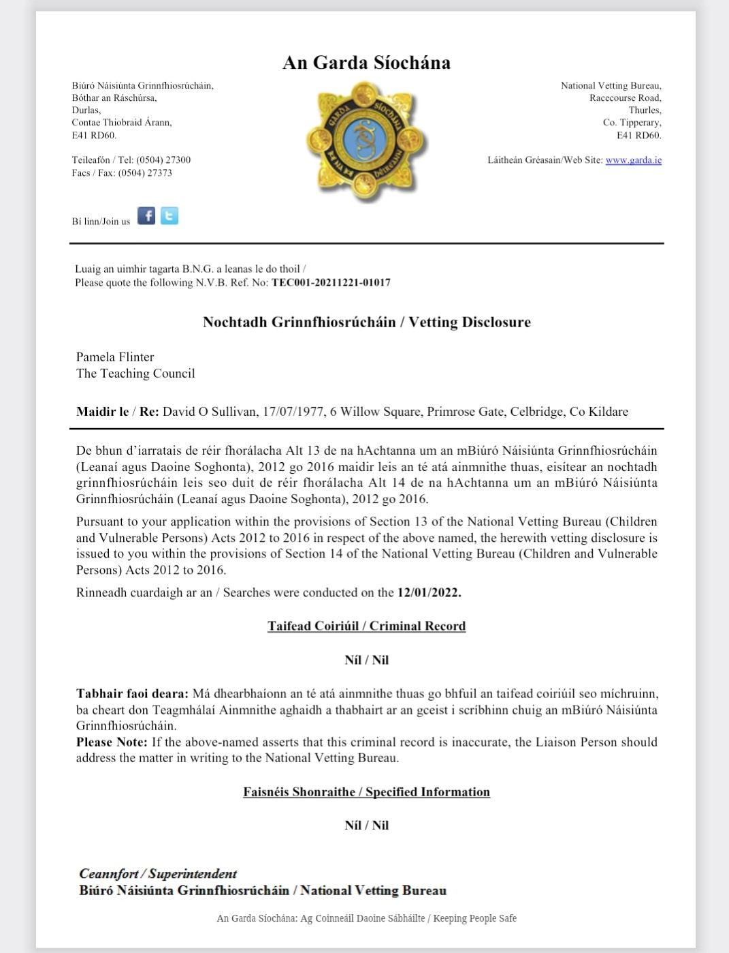

Slide 6
Teaching Council- Registration
Registration Routes
Induction may be placed on your registration
Important – you need to have your Teaching Council registration prior to taking up a temporary or permanent job.
Need to be registered in order to be paid from Oireachtas funds
Subbing – 5 day rule applies without registration

Slide 7

Teaching Council-Registration
Route 1 – Primary Route 2- Post Primary
Initial reg. fee of €90 Requirements:
  Qualifications
  Vetting
Annual re-registration is €65 p.a
Teachers can claim a tax credit for their TC registration fee
www.teachingcouncil.ie

Slide 8
Irish Language Requirement (ILR)
No appropriate Irish language qualification- 3-year period of conditional registration to teach in national schools.
During this period, teachers must work towards meeting the Department’s Irish language requirements
Teachers can either complete an Aptitude Test (SCG – An Scrúdú le hAghaidh Cáilíochta sa Ghaeilge) or an Adaptation Period (OCG – Oiriúnú le hAghaidh Cáilíochta sa Ghaeilge), which confirms the teacher's competence to teach the Irish language as well as a range of primary school curricular subjects through the medium of Irish.
Marino Institute of Education- ilrweb.ie

Slide 9
Pre-Employment: PPS Number
A Personal Public Service (PPS) Number is a unique reference number that helps you access social welfare benefits, public services and information in Ireland.
To apply for a PPS Number you will need to complete Application form for a PPS Number (REG1) and also provide the following:
  Evidence of your address
  Proof of your identity (next slide)
  Proof of reason for why a PPS Number is required
  PPS Number Exceptional Registration Application Form
  Consent Form signed by you if the PPS Number is to issue to a third party representative (e.g. solicitor or accountant)
  Questionnaire

Slide 10
Pre-Employment: PPS Number
Evidence of Your Identity
If you are: | You will need to produce the following as evidence of your identity:
An Irish citizen born in the Republic of Ireland | Your birth certificate and photographic ID, such as your passport or driving licence
An Irish citizen via naturalisation or Foreign Birth Registration | Your current passport or Certificate of Naturalisation OR your Foreign Birth Registration certificate AND Irish or UK driving licence or Irish learner driving permit
An Irish citizen born in Northern Ireland or a UK citizen | Current passport OR your birth certificate showing your mother’s birth surname AND your current driving licence
EU/EEA citizens (other than Irish and UK) | Current passport or national identity card
Non-EU/EEA citizens | Current passport

Slide 11
Starting Employment: Revenue Commissioners
When you start your first job, you should tell Revenue as soon as possible, or you may have to pay emergency tax.
Revenue will send a Revenue payroll notification (RPN) to your new employer.
The RPN will tell your employer how much Income Tax and Universal Social Charge (USC) to deduct from your pay.

Slide 12
Teaching Vacancies
Permanent
Fixed-Term/Temporary – normally one-year contracts
  Covering a teacher on career break/secondment/job sharing
  Paid throughout holidays (only throughout summer if appointed prior to first working day in November)
Substitute
Casual – day to day subbing <40 days
Non-Casual (covering a leave which will run for over 40 days e.g. maternity/parental leave or once you have accumulated over 40 casual subbing days)

Slide 13
Teaching Vacancies
Fixed Term >24 weeks – Advertised
Fixed Term <24 weeks – Not advertised
Teachers must be fully qualified, registered and vetted
Job websites - educationposts.ie; staffroom.ie
Teacher Connect.ie for Substitute vacancies

Slide 14
Appointment Procedures
Made by Board of Management/ETB
Open competition
  Advert – online and in national newspapers
  Selection Board
  Assessment of Applicants
  Interviews
  Appointment by B.O.M.
  Notifies successful candidate/ notifies other candidates

Slide 15

Routes to Permanency
Contract of Indefinite Duration (CID) – in excess of 2 years service in same school with a viable post in the third year
Supplementary Panel – 3 years – all service counts
Open Competition
Benefits of permanency:
  Job/Financial security
  Career break/secondment

Slide 16
Sequence of appointments to permanent teaching vacancies
1st | CID holding teachers or teachers who will be eligible for a CID
2nd | Main Panel (permanent teachers whose posts have been lost)
3rd | Supplementary Panel (non-permanent teachers with at least three years service)
4th | Open Competition

Slide 17

Salary
Primary and Post Primary paid on same scale
Graduate on 1 September 2022 will start on €38,192
Increasing up to €71,503 (Over 24 years)
Increase of 1% due on 1st October 2022
Salary is paid every second Thursday from the DE/ETB

Slide 18
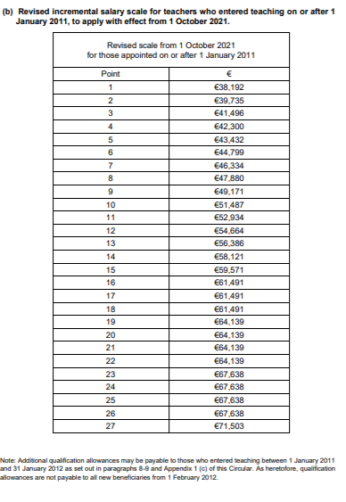
Salary

Slide 19
Rescaling and Incremental Credit
Post-1 January 2011 and Post-1 February 2012 New Entrants to Teaching – Recognition of Previous Public Service in another EU Member State Circular 0027/2016
Incremental Credit- Circular 10/2001
….incremental credit may now be awarded for all recognised teaching service given by qualified teachers in an EU State, provided the criteria is satisfied.
In order for service under this scheme to be recognised, the following criteria must be satisfied:
• the service must have been satisfactory,
• the service must have been remunerated,
• the service must have been full time.
The school in which the service was given must have been:
• subject to State inspection,
• offer a range of studies which incorporates all of the courses prescribed on the National Curriculum for the State in question.

Slide 20
Salary-Payment of Substitutes
Schools will input sub days worked for payment on the Online Claims System
Substitute teachers will always be at least two weeks behind in salary due to the early closure for substitute claims through the OLCS
Substitutes are paid fortnightly
Substitute rates- Circular 56/2021

Slide 21
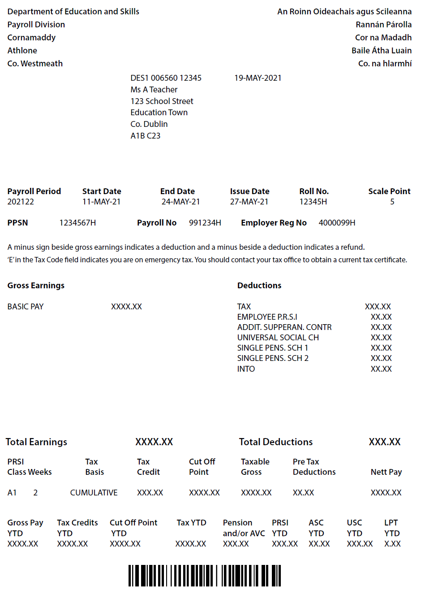
Understanding
Your Payslip
Gross income on left-hand side, and deductions on the right
If DE are making a deduction, it will appear as a minus figure on the income side (e.g. maternity benefit, illness benefit, recoupment of overpayment)
Current point on the scale is indicated on top right
Net take home pay is on the bottom right
PRSI Class is at lower left

Slide 22
Understanding
Your Payslip
Pension contributions –
  Pre 2013: Pension Grouped
  Spouse and Children Scheme
  Post 2013: Single Pen Sch. 1
  Single Pen Sch. 2
  Both will have: Additional Superannuation Contribution
PAYE, USC
INTO membership – 0.75% of salary, capped at the equivalent of point 11 of post 2011 scale
Other deductions – Comhar Linn, VHI, AVCs etc

Slide 23
Substitute teachers
Casual rate – if you have worked <40 days in school year
Non-casual rate – after you have worked more than 40 days in a school year
Non-casual sub teachers entitled to paid leave e.g. - sick leave, maternity leave, wedding leave, family illness leave etc. Can also apply to take EPV days.

Slide 24
Temporary teachers – holiday pay
If a teacher takes up a temporary contract before the first working day in November they will be paid until August 31st.
If a teachers takes up a temporary contract after the first working day in November, they may be entitled to retrospective holiday pay for the summer if they secure a further fixed term contract for the following school year which does not end any earlier than a year from the start date of the previous contract
Supply panel positions

Slide 25


Pension-Public Service ‘Single’ Scheme
Compulsory retirement at age 70
Retirement from date of State (Contributory) Pension 66/67/68 from 2014 to 2028
Career Average Basis (not final salary): Notional value set aside annually
CNER from age 55 onwards

Slide 26
Pension-Public Service ‘Single’ Scheme
This is the minimum length of time that you must have paid into the Scheme before you can access Single Scheme benefits. The Single Scheme vesting period is 24 months in total.
Your work pattern (i.e. full-time or part-time) is not taken into account when deciding if you have completed the vesting period or not. This means that regardless of the number of hours you work on a particular day, it fully counts for vesting purposes.
When considering if you have completed the Single Scheme vesting period, your employer must include any earlier periods of Single Scheme membership that you may have had with other public service employers.

Slide 27

Additional Superannuation Contribution (ASC)
Member of a Standard Accrual Pension Scheme- Jan 2020
Amount of Remuneration | Rate of Deduction
Up to €34,5000 | Exempt (worth €250 PA)
Between €32,000 and €60,000 | 10%
Over 60,000 | 10.5%
From Jan 2020
Member of Single Service Pension Scheme –Jan 2020
Amount of Remuneration | Rate of Deduction
Up to €34,5000 | Exempt (worth €250 PA)
Between €32,000 and €60,000 | 3.33%
Over 60,000 | 3.5%

Slide 28
Social Insurance
On 31 January 2020, the UK exited the EU.
The Convention on Social Security between Ireland and the United Kingdom maintains the recognition of, and access to, social insurance entitlements in both jurisdictions.
This means that the rights of Irish citizens living in Ireland to benefit from social insurance contributions made when working in the UK are protected and vice versa.
Irish social welfare payments covered by the Convention.
Irish social welfare payments covered by the Convention.

Slide 29
Leave
Statutory | Non-Statutory
Maternity Leave | Career break
Paternity Leave | Job-Sharing
Parent’s Leave | Secondment
Parental leave | Brief Absences
Carer’s Leave | Unpaid Leave
Adoptive Leave | Sick Leave
 | Special Leave with Pay

Slide 30
Other Matters
School year
  Primary is 183 days
  Post Primary is 167 days
Work week
  Primary is 25 hours
  Post Primary -18 or 22 hour (full contract)
School Day at Primary is 5 hours 40 mins
Croke Park hours- 37 at Primary level and 33 at Post Primary

Slide 31

Any Questions?

